Slide 1
The Lake
of Fire
Notes:
Download this presentation free at:
www.2ndAdventRevivalMinistry.com

Slide 2
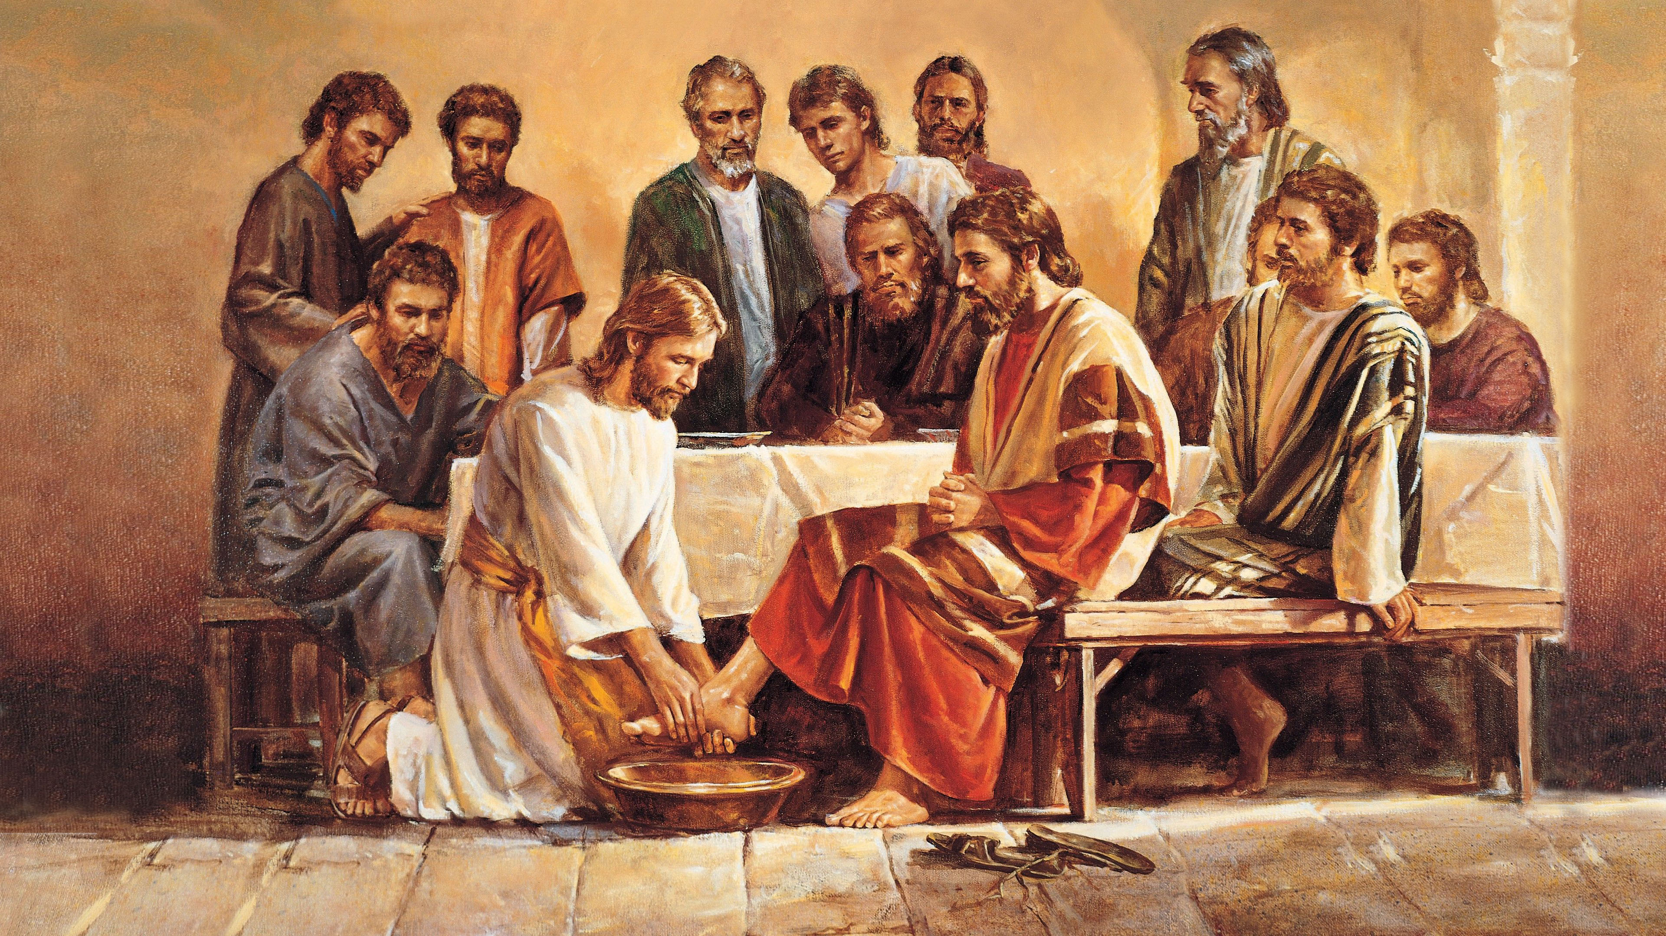
Next verse: 1 John 3:1; 4:8
Notes:
Welcome to our study on The Lake of Fire. Some people wonder, Would God really burn people in hell fire? Is this the same God that healed people and held little children on His knee? The God Who washed His disciples feet?
What is God really like?

Slide 3
1 John 3:1
Behold what manner of love the Father has bestowed on us, that we should be called ________ of ___!
1 John 4:8
He who does not love does not know God, for God is ____.
Notes:
.
1 John 3:1
Behold what manner of love the Father has bestowed on us, that we should be called children of God!
1 John 4:8
He who does not love does not know God, for God is love.

Slide 4
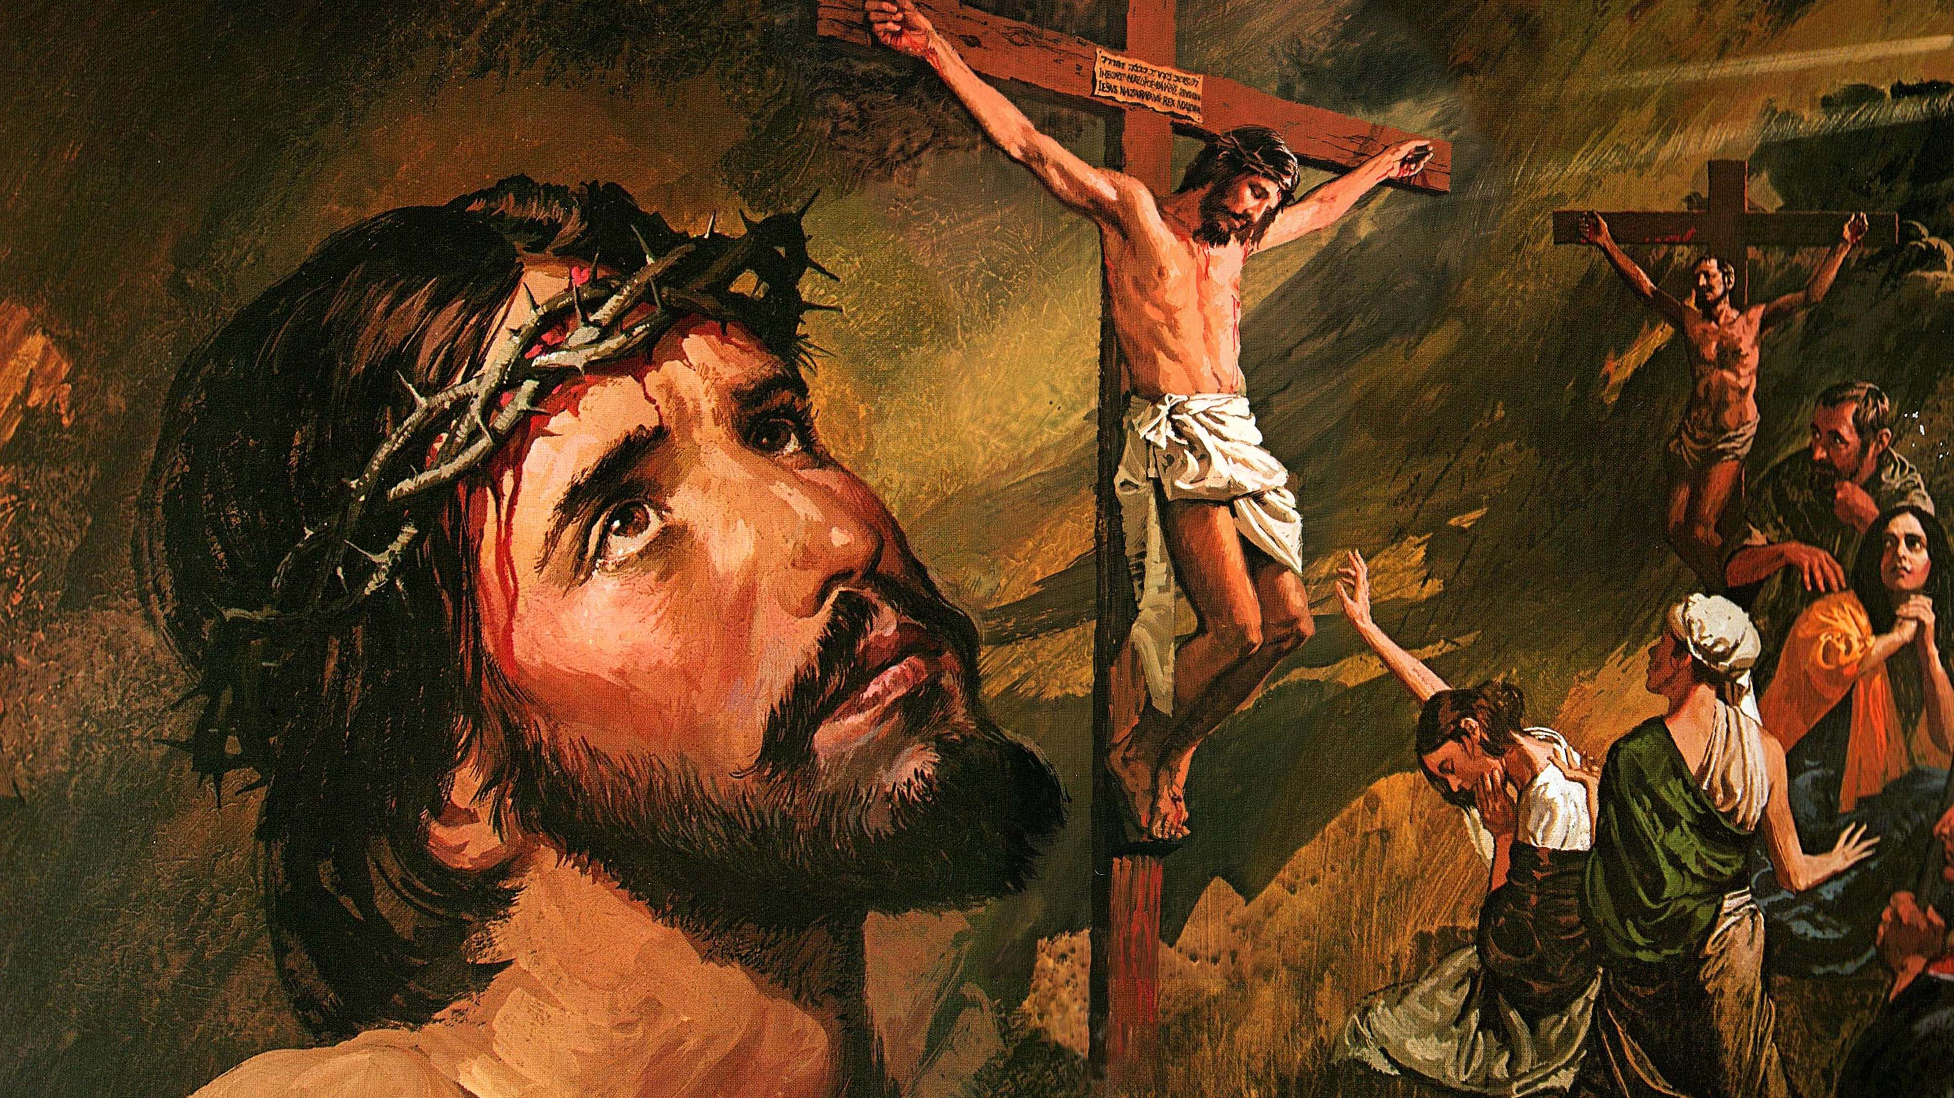
Next verse: 2 Peter 3:9
Notes:
There is no love like God’s love. He gave everything so we could be reunited with Him. He died to reclaim us – sinful, unworthy mortals – as children of the King of the Universe. He can’t wait to come back and get us and take us home to be with Him forever. John couldn’t find words for this love. All he could say was, “Look at this!” On the cross, Jesus won the right to save every person who does not refuse His love.
Does that include everyone?

Slide 5
2 Peter 3:9
The Lord is not slack concerning His promise, as some count slackness, but is longsuffering toward us, not willing that any should ______ but that ___ should come to repentance.
Notes:
.
2 Peter 3:9
The Lord is not slack concerning His promise, as some count slackness, but is longsuffering toward us, not willing that any should perish but that all should come to repentance.

Slide 6
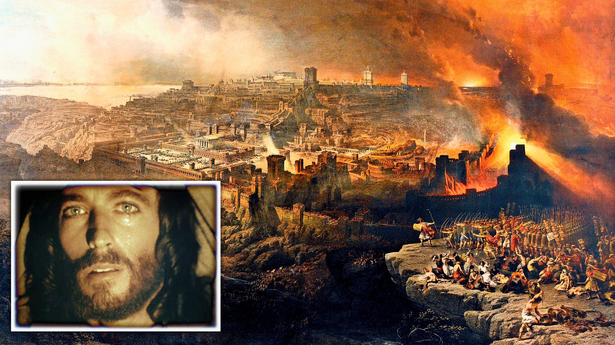
Next verse: Hosea 13:9 KJV, Jeremiah 6:19
Notes:
For more than a thousand years the Jewish nation had abused God’s mercy, rejected His warnings, and killed His prophets. Jesus Himself walked among them for three and a half years. He “went about doing good and healing all who were oppressed by the devil”.* Now He was about to be crucified by the people He had come to save. His tears were not for Himself, but for them, and for those in all ages who refuse His grace and mercy. He had exhausted every resource to save them. Looking into the future, He wept over their coming destruction.
How does this parallel our day?
*Acts 10:38

Slide 7
Hosea 13:9 KJV
O Israel, thou hast destroyed thyself; but in Me is thine help.
Jeremiah 6:19
Hear, O earth! Behold, I will certainly bring calamity on this people—the fruit of their thoughts, because they have not heeded My _____ nor My ___, but ________ it.
Notes:
.
Hosea 13:9 KJV
O Israel, thou hast destroyed thyself; but in Me is thine help.
Jeremiah 6:19
Hear, O earth! Behold, I will certainly bring calamity on this people—the fruit of their thoughts, because they have not heeded My words nor My law, but rejected it.

Slide 8
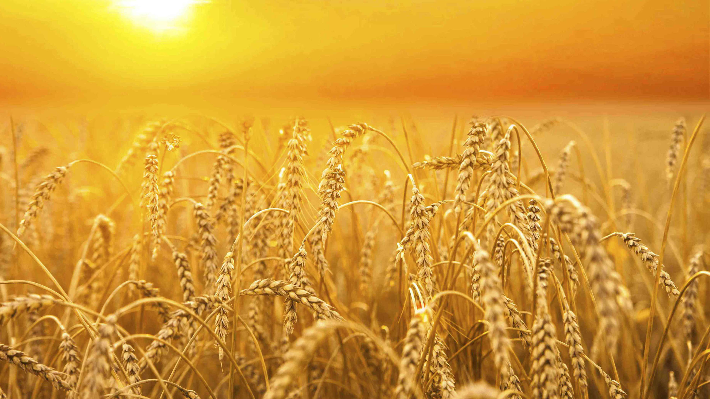
Next verse: Matthew 13:30,40
Notes:
Jesus told a story about a farmer who sowed his field with wheat. While he was asleep, an enemy came and planted weeds in his field, which sprouted and grew along with the wheat. His servants asked if they should pull them out, but he said, “No, you might uproot the wheat.” At harvest time, the wheat was gathered into the barn, while the weeds were collected and burned.
How does this parable illustrate the final destruction of the wicked?

Slide 9
Matthew 13:30,40
Let both grow together until the _______, and at the time of harvest I will say to the reapers, “First gather together the tares and bind them in bundles to burn them, but gather the wheat into my barn.” (40) Therefore as the tares are gathered and ______ in the fire, so it will be at the ___ of this age.
Notes:
.
Matthew 13:30,40
Let both grow together until the harvest, and at the time of harvest I will say to the reapers, “First gather together the tares and bind them in bundles to burn them, but gather the wheat into my barn.” (40) Therefore as the tares are gathered and burned in the fire, so it will be at the end of this age.

Slide 10
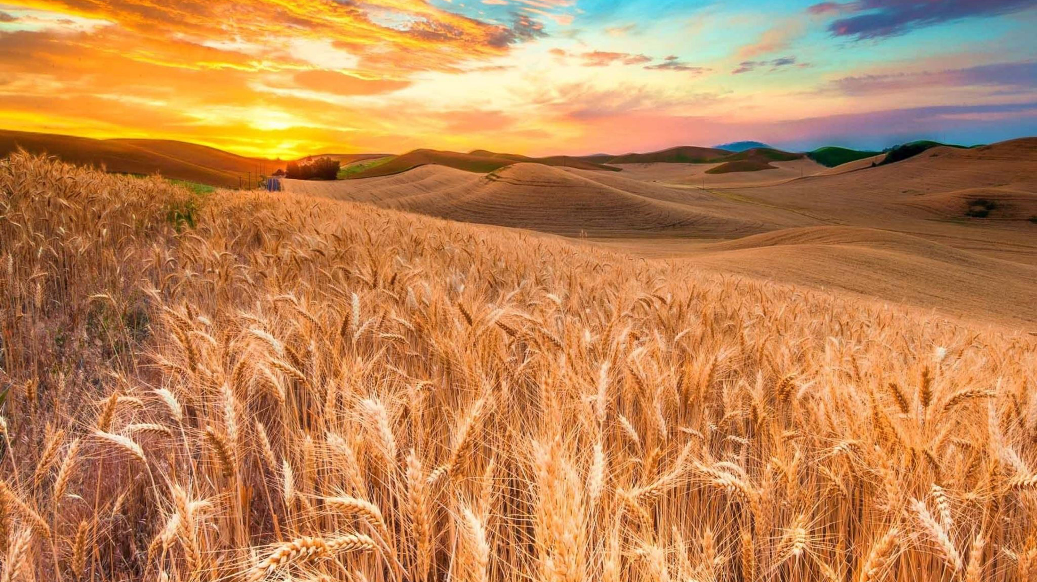
Next verse: 2 Peter 2:9
Notes:
As the tares are gathered in bundles to be burned, so the wicked are destroyed in the lake of fire “at the end of this age”.*
This cannot happen until judgment is executed. How do we know the wicked are not being destroyed right now?
*Matthew 13:40

Slide 11
2 Peter 2:9
Then the Lord knows how to deliver the godly out of temptations and to reserve the unjust under punishment for the day of ________.
Notes:
.
2 Peter 2:9
Then the Lord knows how to deliver the godly out of temptations and to reserve the unjust under punishment for the day of judgment.

Slide 12
Next verse: 2 Peter 3:5-7
Notes:
The wicked are “reserved” for the day of judgment. A reservation is an appointment that comes at a later date. No one is burning now.
When will the fire start?

Slide 13
2 Peter 3:5-7
For this they willfully forget: that by the word of God the heavens were of old, and the earth standing out of water and in the water, (6) by which the world that then existed perished, being flooded with water. (7) But the heavens and the earth which are now preserved by the same word, are ________ for ____ until the day of ________ and perdition of ungodly men.
Notes:
.
2 Peter 3:5-7
For this they willfully forget: that by the word of God the heavens were of old, and the earth standing out of water and in the water, (6) by which the world that then existed perished, being flooded with water. (7) But the heavens and the earth which are now preserved by the same word, are reserved for fire until the day of judgment and perdition of ungodly men.

Slide 14
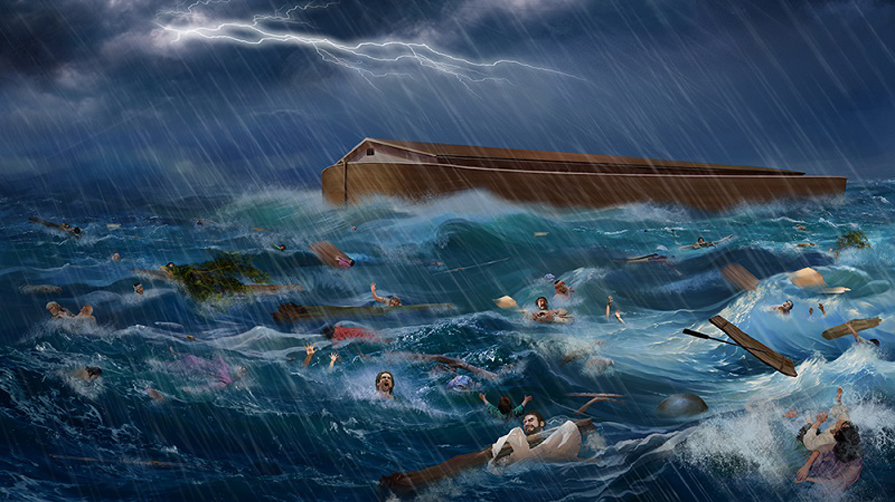
Next verse: Job 21:30
Notes:
The world was destroyed by water in the time of Noah. The final destruction by fire is yet to come. As the wicked were destroyed by water in the flood, they will be destroyed by fire in the day of perdition. Where are the wicked now?

Slide 15
Job 21:30
For the wicked are ________ for the day of ____; they shall be brought out on the day of wrath.
Notes:
.
Job 21:30
For the wicked are reserved for the day of doom; they shall be brought out on the day of wrath.

Slide 16
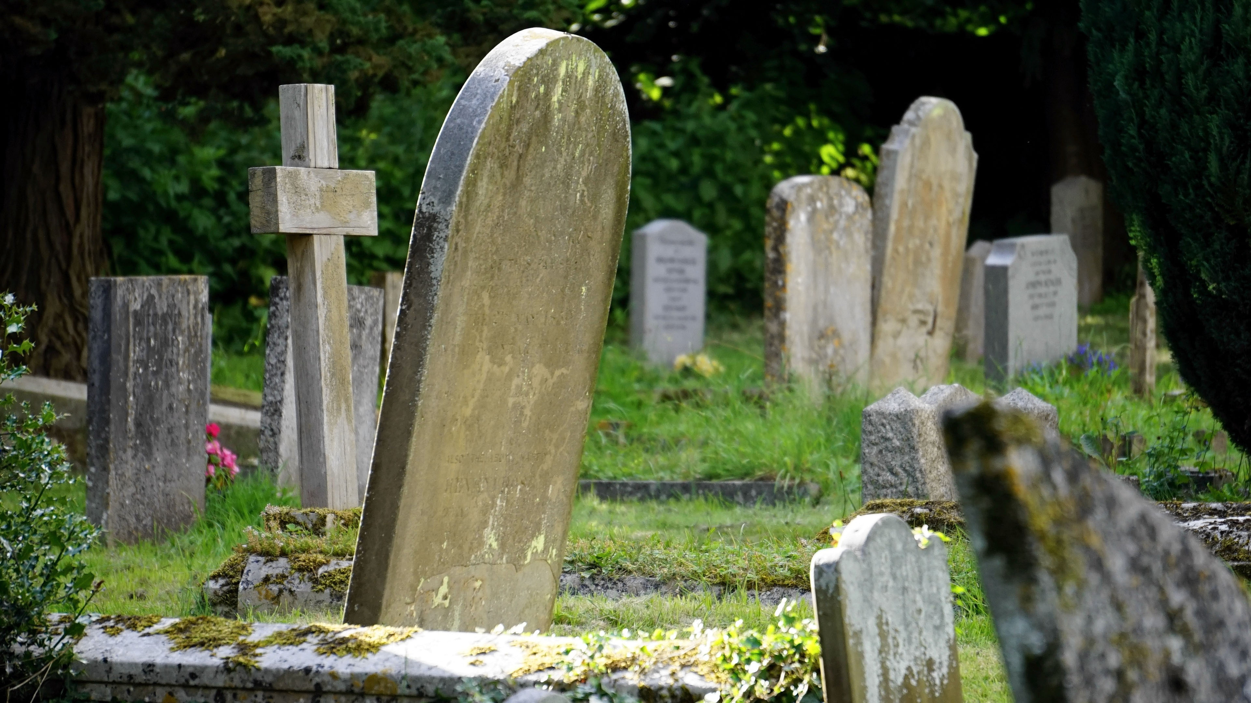
Next verse: John 5:28,29
Notes:
Those who have died are asleep in their graves. We see from the previous verses that the wicked are reserved in their graves and will be brought out for judgment and punishment.
How did Jesus describe this?

Slide 17
John 5:28,29
Do not marvel at this; for the hour is coming in which all who are in the graves will hear His voice (29) and come forth—those who have done good, to the resurrection of life, and those who have done evil, to the ____________ of ____________.
Notes:
.
John 5:28,29
Do not marvel at this; for the hour is coming in which all who are in the graves will hear His voice (29) and come forth—those who have done good, to the resurrection of life, and those who have done evil, to the resurrection of condemnation.

Slide 18
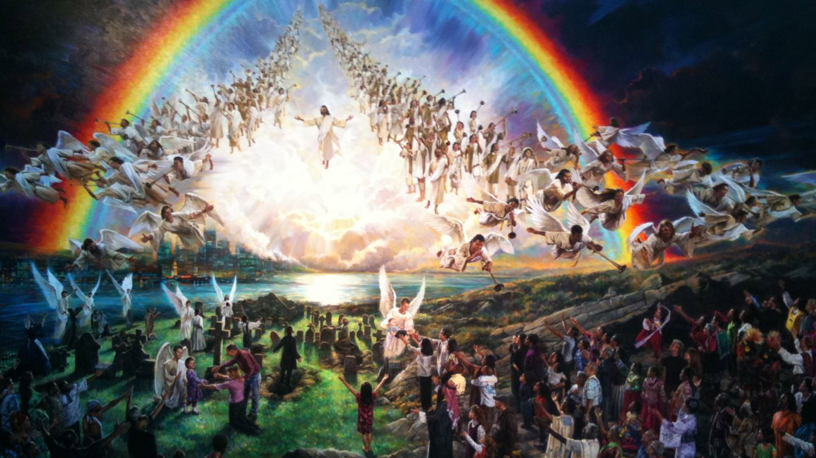
Next verse:Revelation 22:12
Notes:
The righteous and the wicked remain in their graves until the resurrection, when they are raised back to life.
Why can’t the wicked be punished before Jesus returns?

Slide 19
Revelation 22:12
“And behold, I am coming quickly, and My reward is ____ __, to give to every one according to his work”.
Notes:
.
Revelation 22:12
“And behold, I am coming quickly, and My reward is with Me, to give to every one according to his work.”

Slide 20
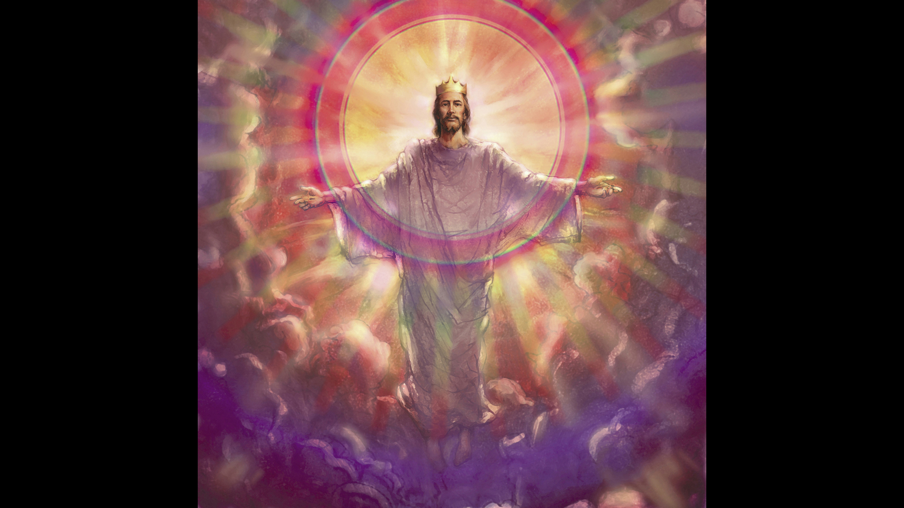
Next verse: 2 Peter 3:10
Notes:
No one is burning now. No one receives rewards until the return of Jesus. That day is coming.
What will happen to the wicked?

Slide 21
2 Peter 3:10
But the day of the Lord will come as a thief in the night, in which the heavens will pass away with a great noise, and the elements will melt with fervent heat; both the earth and the works that are in it will be ______ __.
Notes:
.
2 Peter 3:10
But the day of the Lord will come as a thief in the night, in which the heavens will pass away with a great noise, and the elements will melt with fervent heat; both the earth and the works that are in it will be burned up.

Slide 22
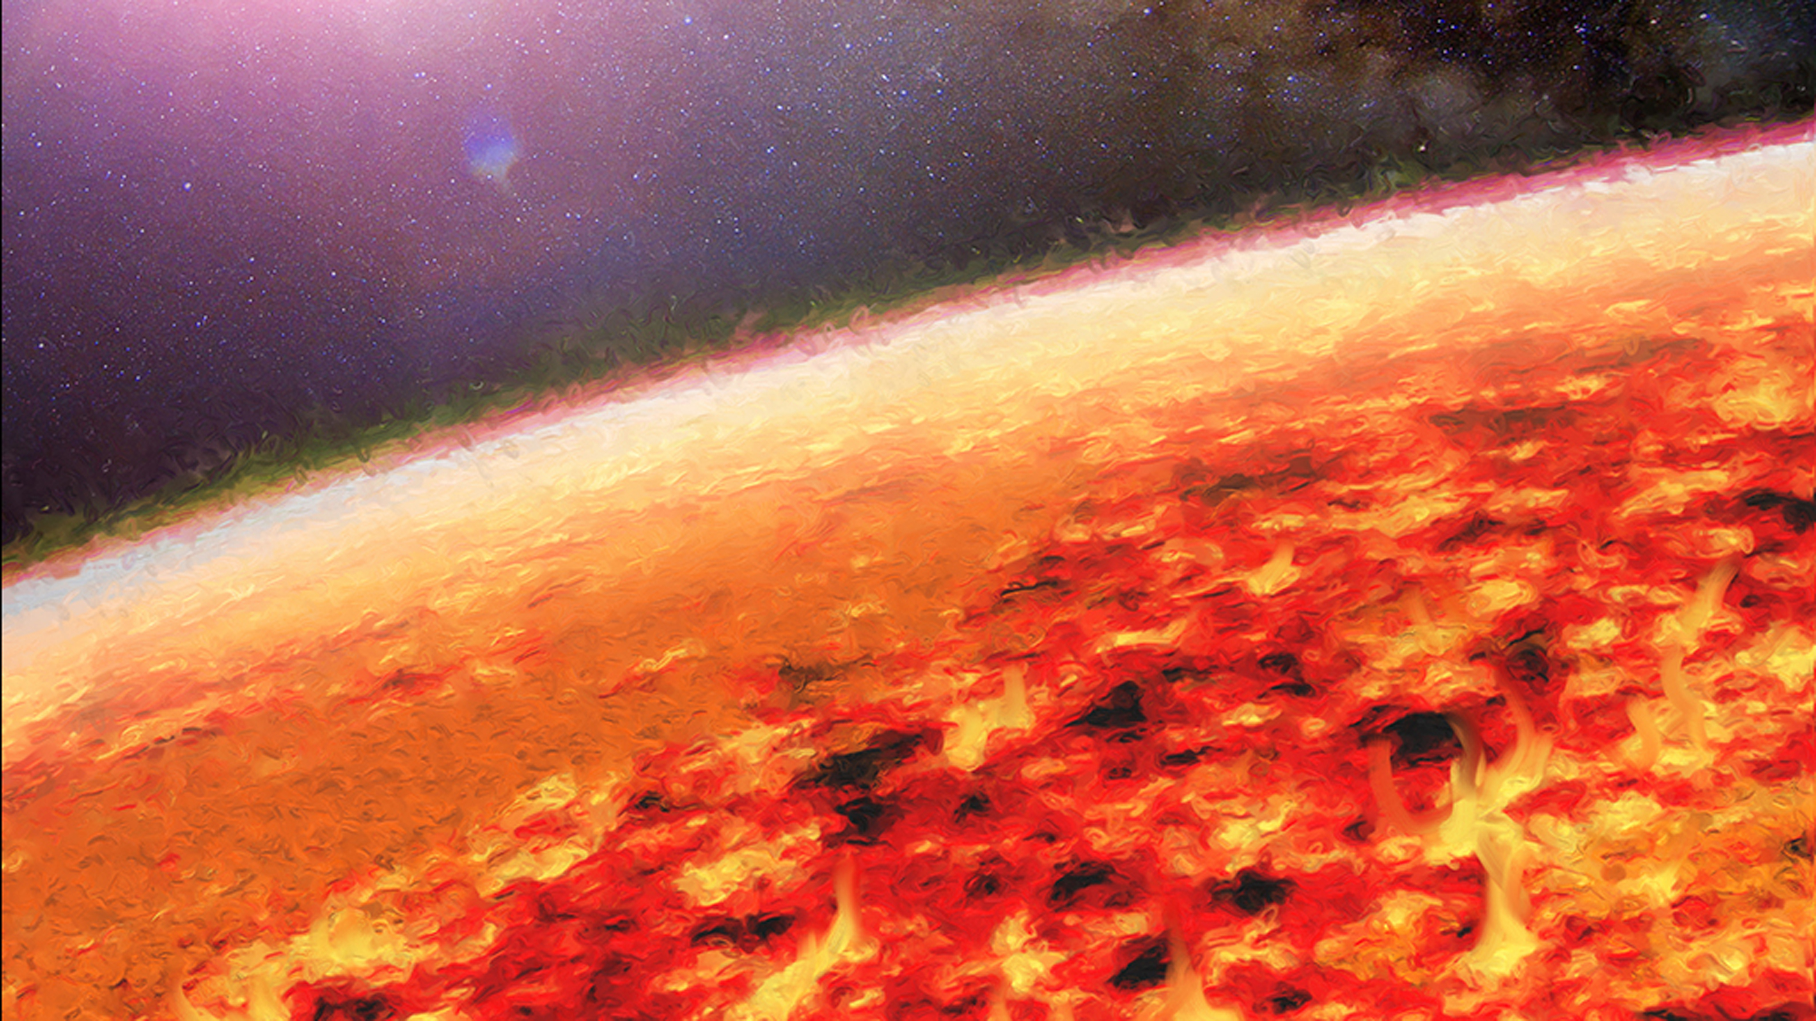
Next verse: Matthew 10:28
Notes:
So is there really a hell? What did Jesus say about it?

Slide 23
Matthew 10:28
And do not fear those who kill the body but cannot kill the soul. But rather fear Him who is able to _______ both soul and body in ____.
Notes:
.
Matthew 10:28
And do not fear those who kill the body but cannot kill the soul. But rather fear Him who is able to destroy both soul and body in hell.

Slide 24
Next verse: Revelation 20:15
Notes:
Jesus said both soul and body are destroyed in hell. Do the wicked continue to burn forever?

Slide 25
Psalm 37:9-11
For evildoers shall be ___ ___; but those who wait on the Lord, they shall inherit the earth. (10) For yet a little while and the wicked shall be __ ____; indeed, you will look carefully for his place, but it shall be no more. (11) But the meek shall inherit the earth, and shall delight themselves in the abundance of peace.
Notes:
.
Psalm 37:9-11
For evildoers shall be cut off; but those who wait on the Lord, they shall inherit the earth. (10) For yet a little while and the wicked shall be no more; indeed, you will look carefully for his place, but it shall be no more. (11) But the meek shall inherit the earth, and shall delight themselves in the abundance of peace.

Slide 26
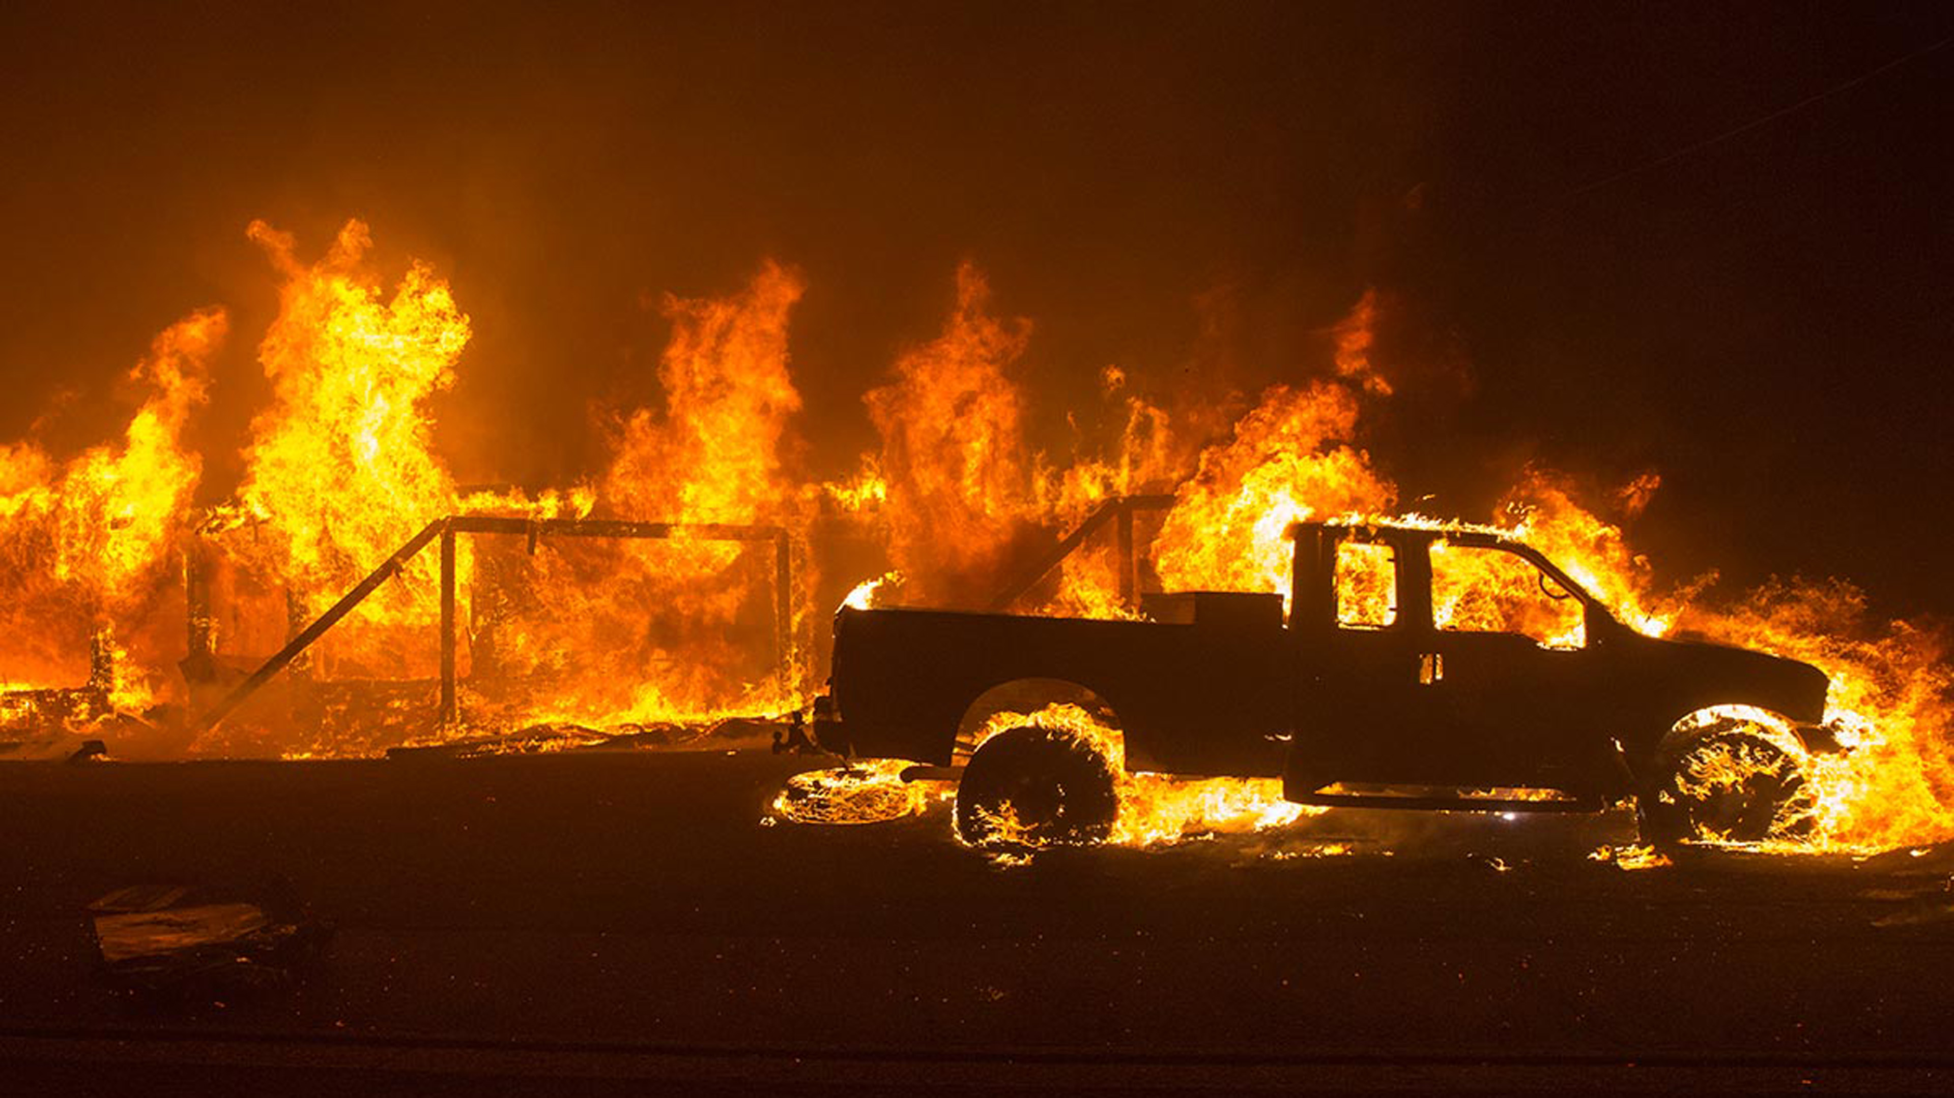
Next verse: Isaiah 47:14
Notes:
The wicked will be “cut off”. They will be “no more”. Will the fire eventually go out?

Slide 27
Isaiah 47:14
Behold, they shall be as stubble, the fire shall burn them; they shall not deliver themselves from the power of the flame; it shall not be a ____ to be warmed by, nor a ____ to sit before!
Notes:
.
Isaiah 47:14
Behold, they shall be as stubble, the fire shall burn them; they shall not deliver themselves from the power of the flame; it shall not be a coal to be warmed by, nor a fire to sit before!

Slide 28
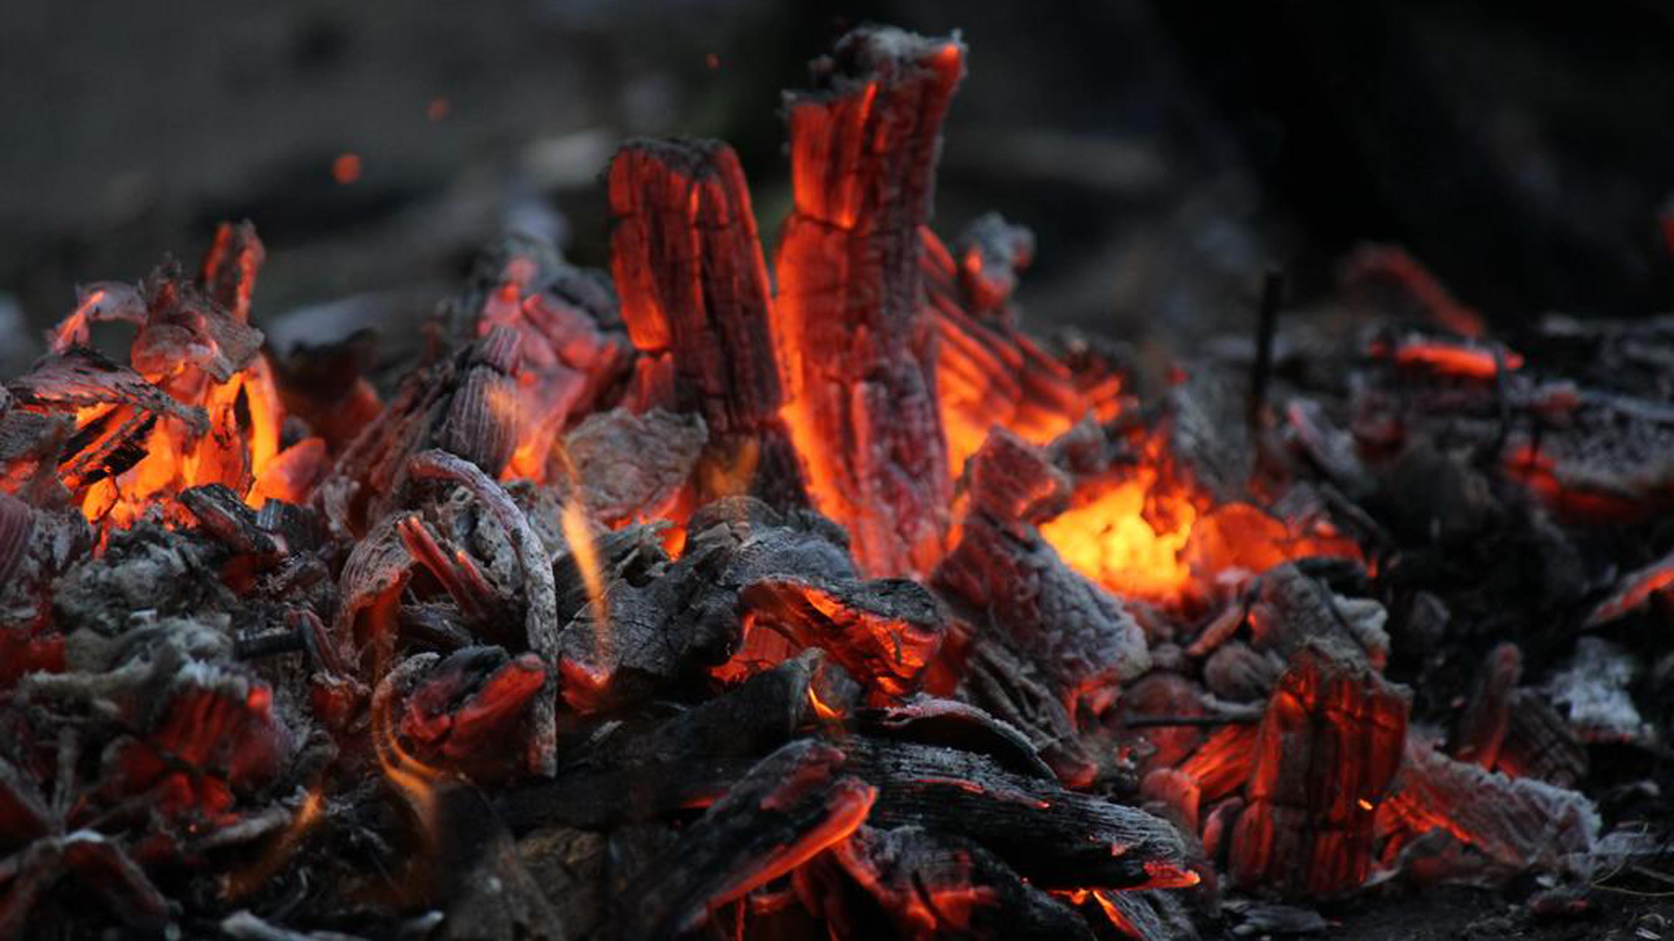
Next verse: Malachi 4:1,3
Notes:
When the fire has done its work, it will go out. There will not be even a coal left to warm oneself by.
What will the wicked become?

Slide 29
Malachi 4:1,3
“For behold, the day is coming, burning like an oven, and all the proud, yes, all who do wickedly will be stubble. And the day which is coming shall ____ them __,” says the LORD of hosts, “That will leave them neither root nor branch... (3) You shall trample the wicked, for they shall be _____ under the soles of your feet on the day that I do this,” says the LORD of Hosts.
Notes:
.
Malachi 4:1,3
“For behold, the day is coming, burning like an oven, and all the proud, yes, all who do wickedly will be stubble. And the day which is coming shall burn them up,” says the LORD of hosts, “That will leave them neither root nor branch... (3) You shall trample the wicked, for they shall be ashes under the soles of your feet on the day that I do this,” says the LORD of Hosts.

Slide 30
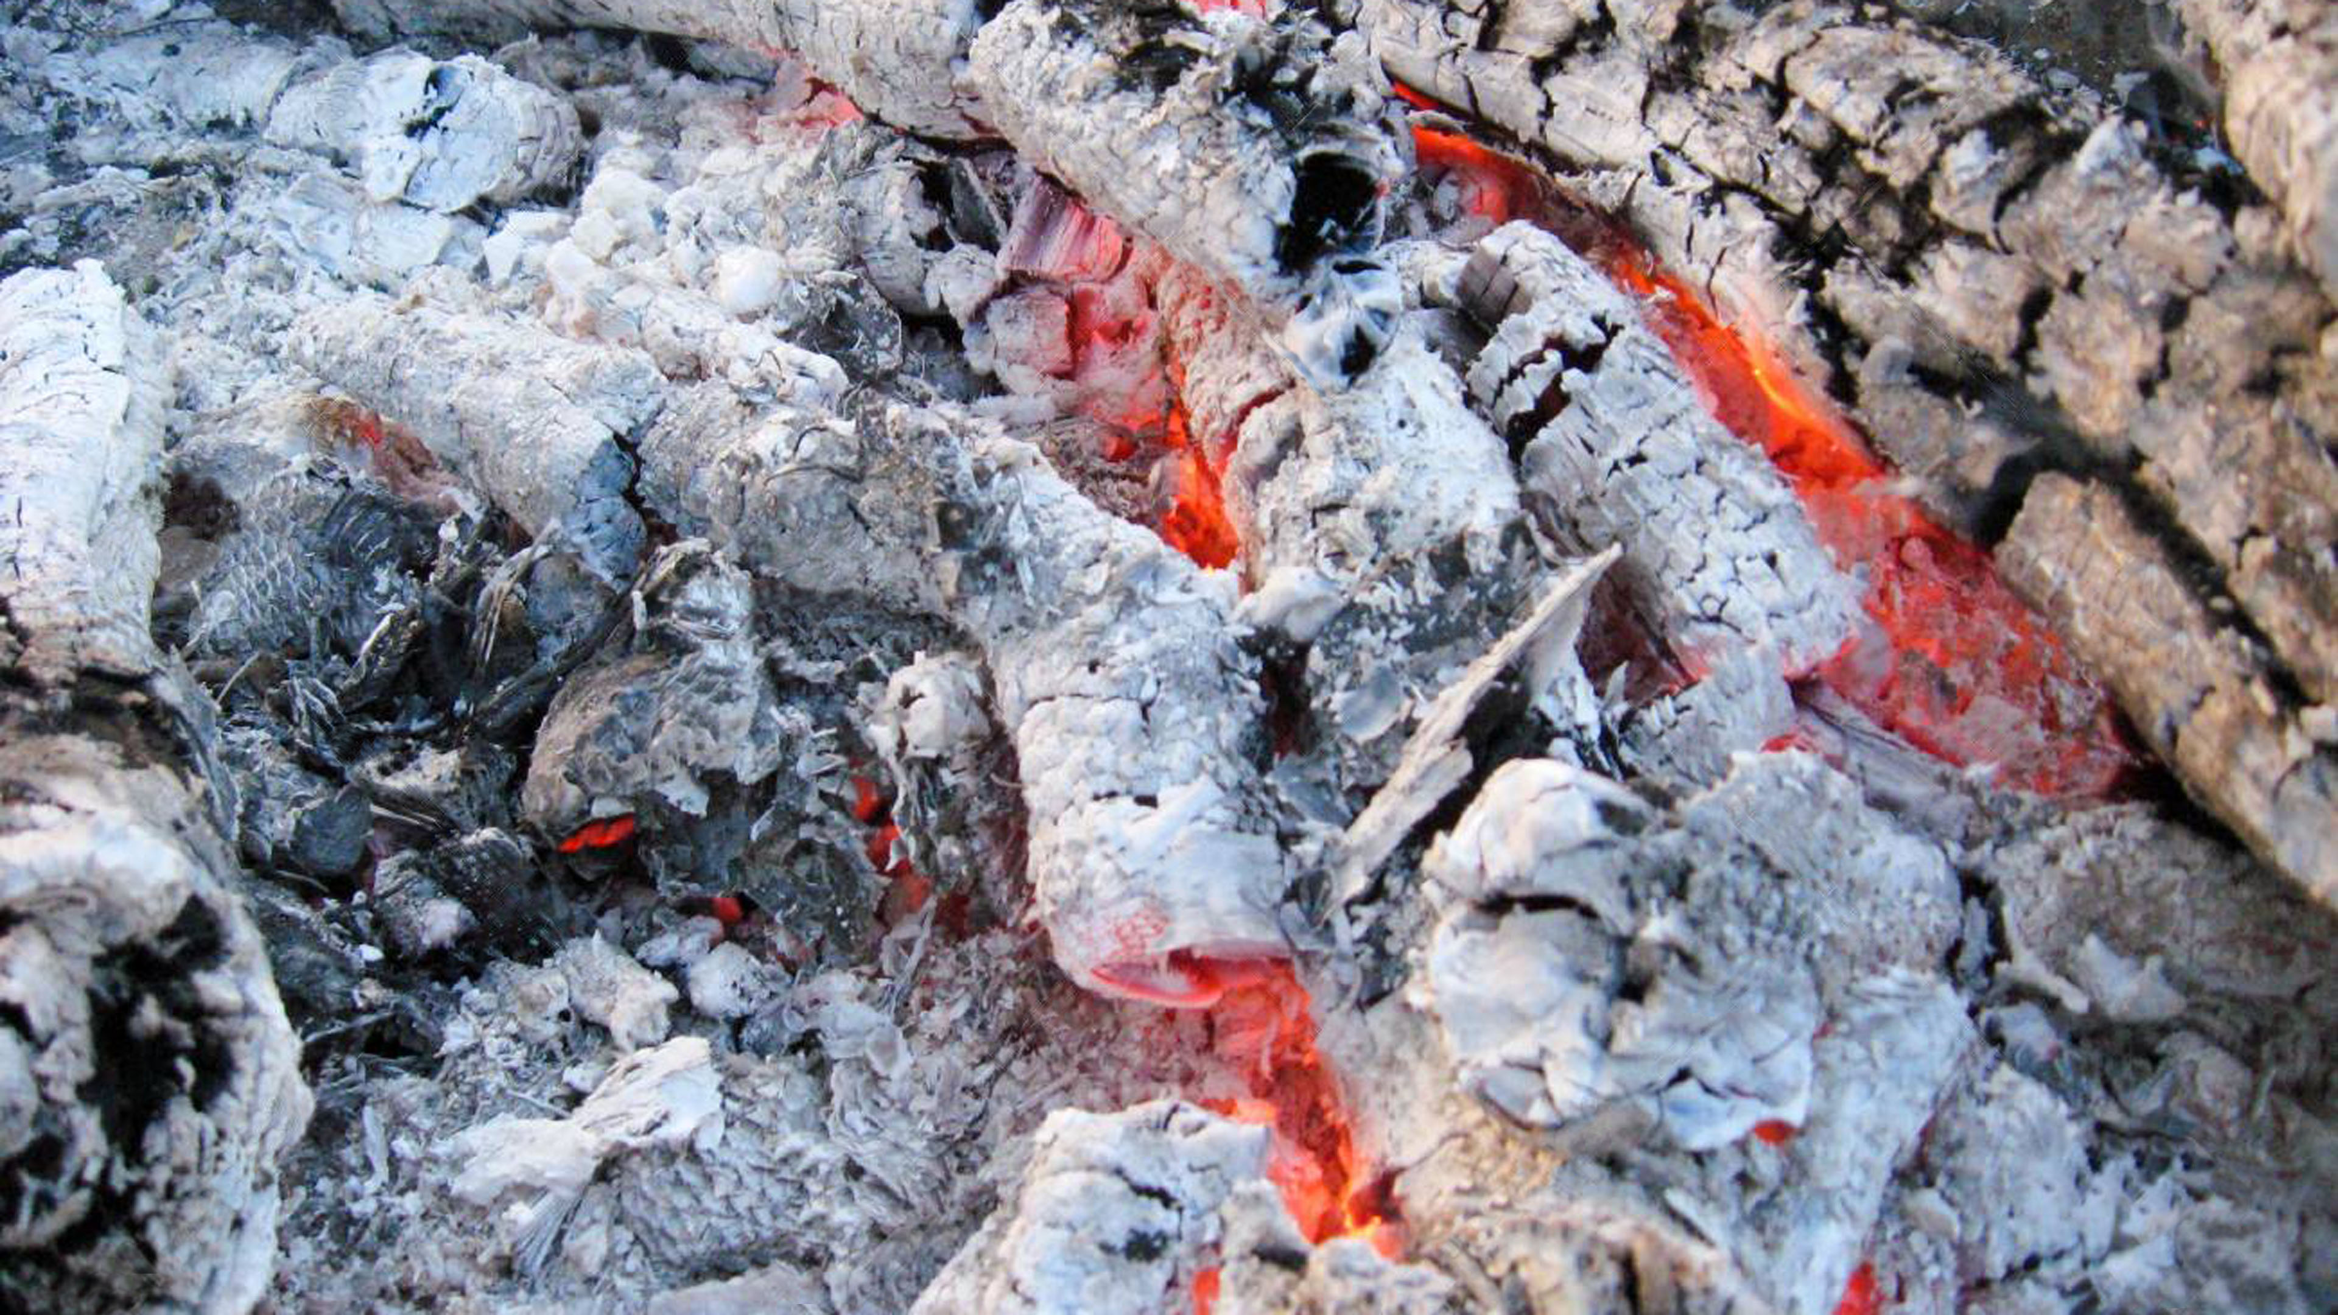
Next verse: Revelation 20:9
Notes:
The Bible says the wicked will be burned up and they will become ashes under our feet.
Where does this fire happen?

Slide 31
Revelation 20:9
They went up on the breadth of the _____ and surrounded the camp of the saints and the beloved city. And fire came down from God out of ______ and devoured them.
Notes:
.
Revelation 20:9
They went up on the breadth of the earth and surrounded the camp of the saints and the beloved city. And fire came down from God out of heaven and devoured them.

Slide 32
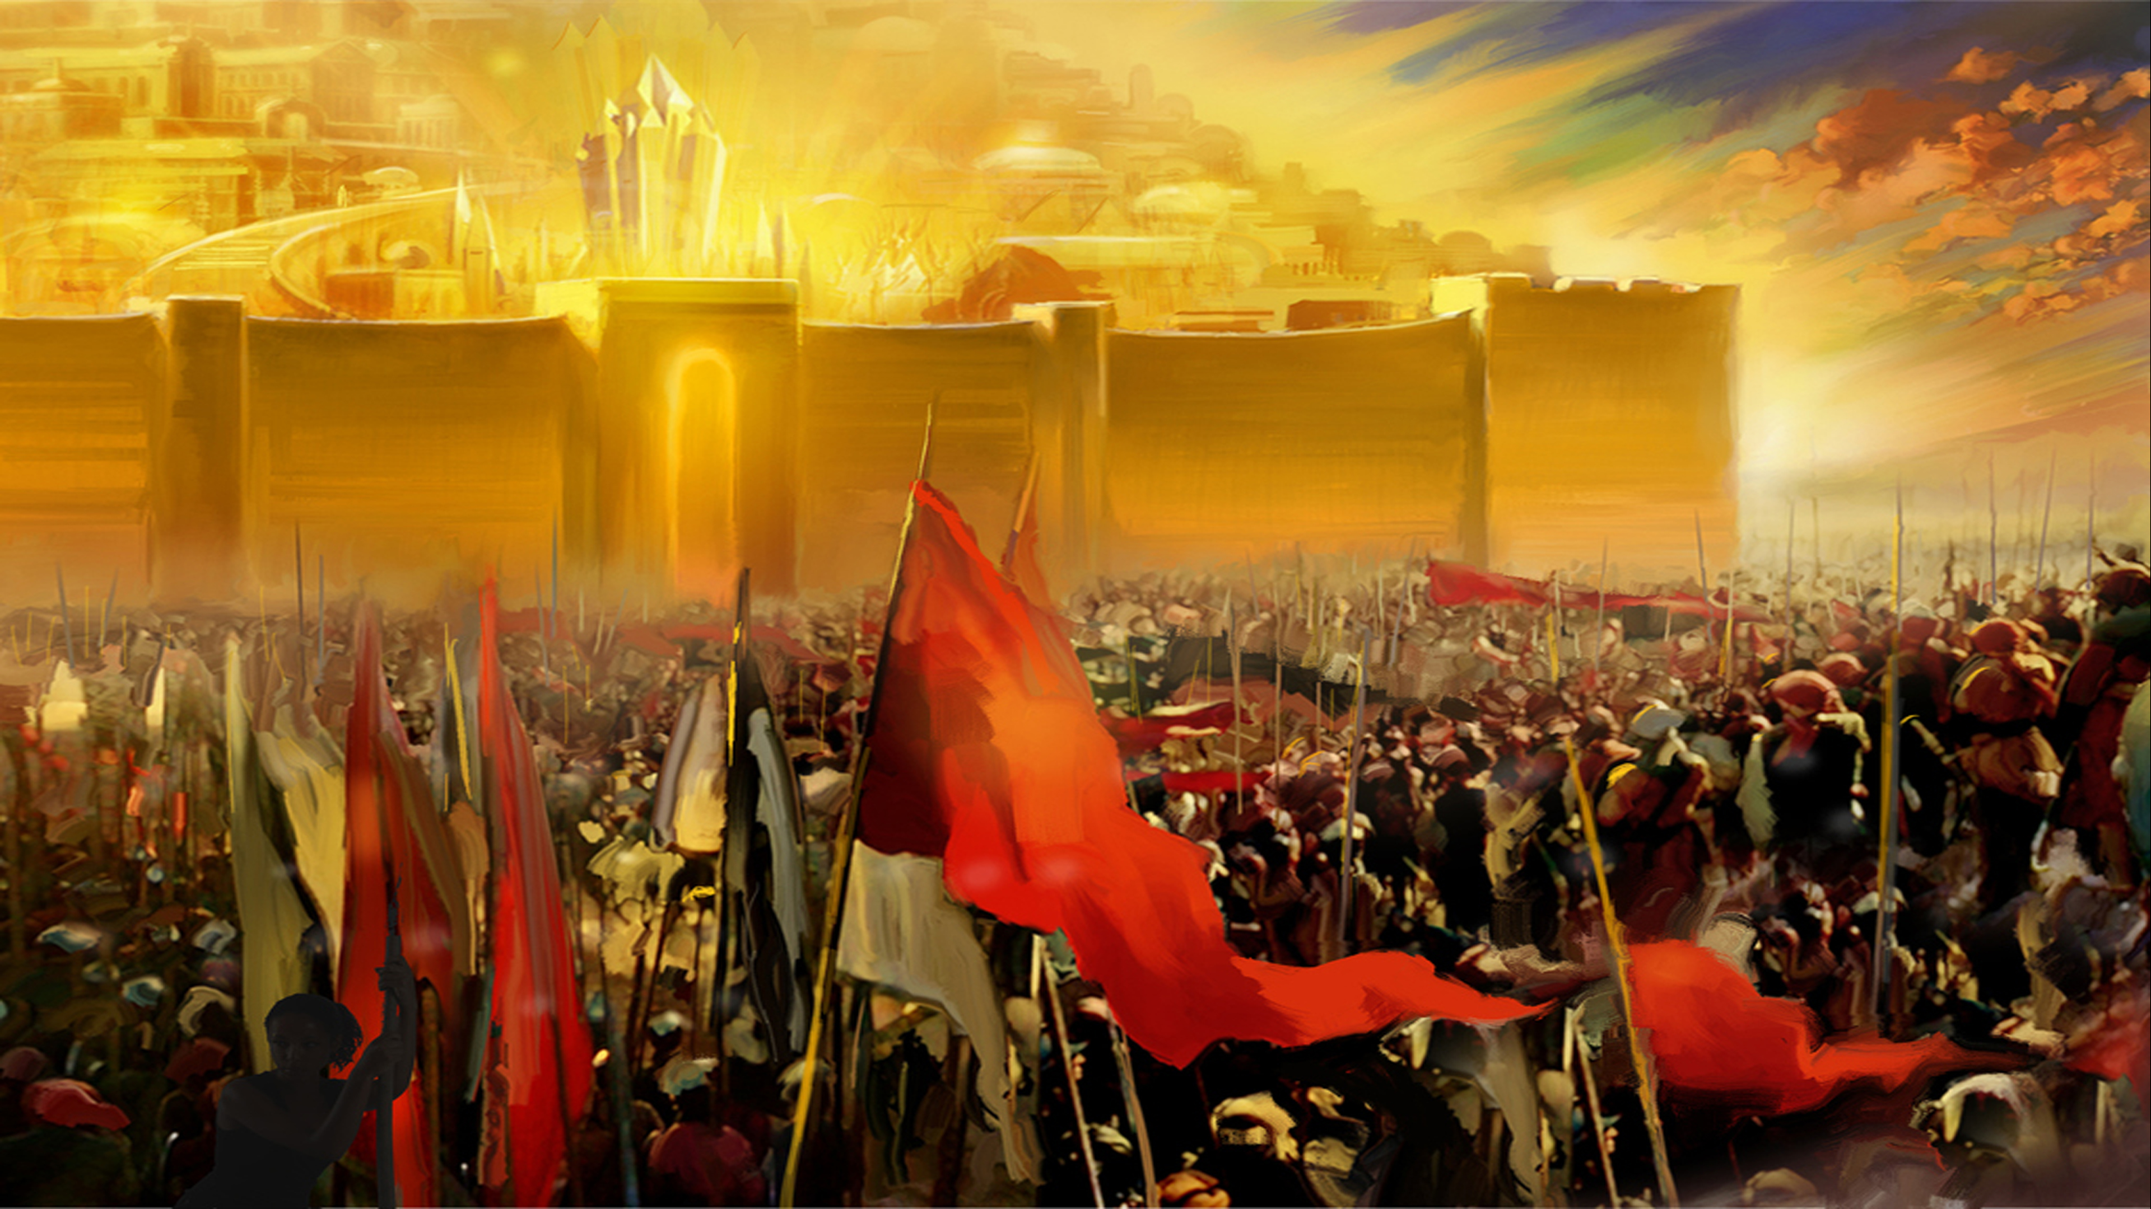
Next verse: Romans 6:23
Notes:
Some people think that hell is burning in the center of the earth. But the Bible says that fire from heaven comes down on the earth and burns up the devil, the wicked, everything.
Do they continue to burn forever?

Slide 33
Romans 6:23
For the wages of sin is _____, but the gift of God is _______ ____ in Christ our Lord.
Notes:
.
Romans 6:23
For the wages of sin is death, but the gift of God is eternal life in Christ our Lord.

Slide 34
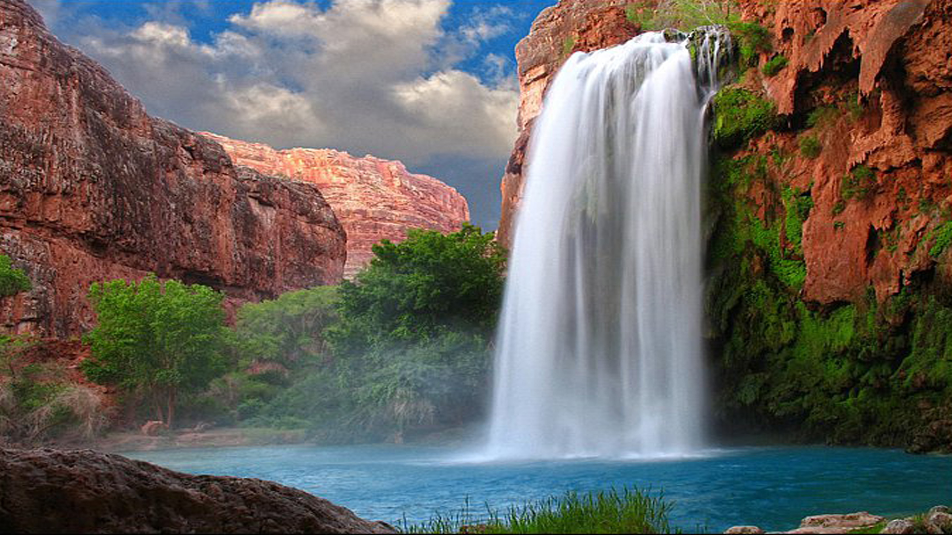
Next verse: Ezekiel 18:4
Notes:
The Bible says the wages of sin is death, not eternal torment. Eternal life is given only to the righteous, not the wicked. John 3:16 says that God gave His Son “so that whoever believes in Him should not perish, but have everlasting life”. The wicked are the ones who perish.
Do their souls continue to exist?

Slide 35
Ezekiel 18:4
Behold all souls are Mine; the soul of the father as well as the soul of the son is Mine; the soul who sins shall ___.
Notes:
.
Ezekiel 18:4
Behold all souls are Mine; the soul of the father as well as the soul of the son is Mine; the soul who sins shall die.

Slide 36
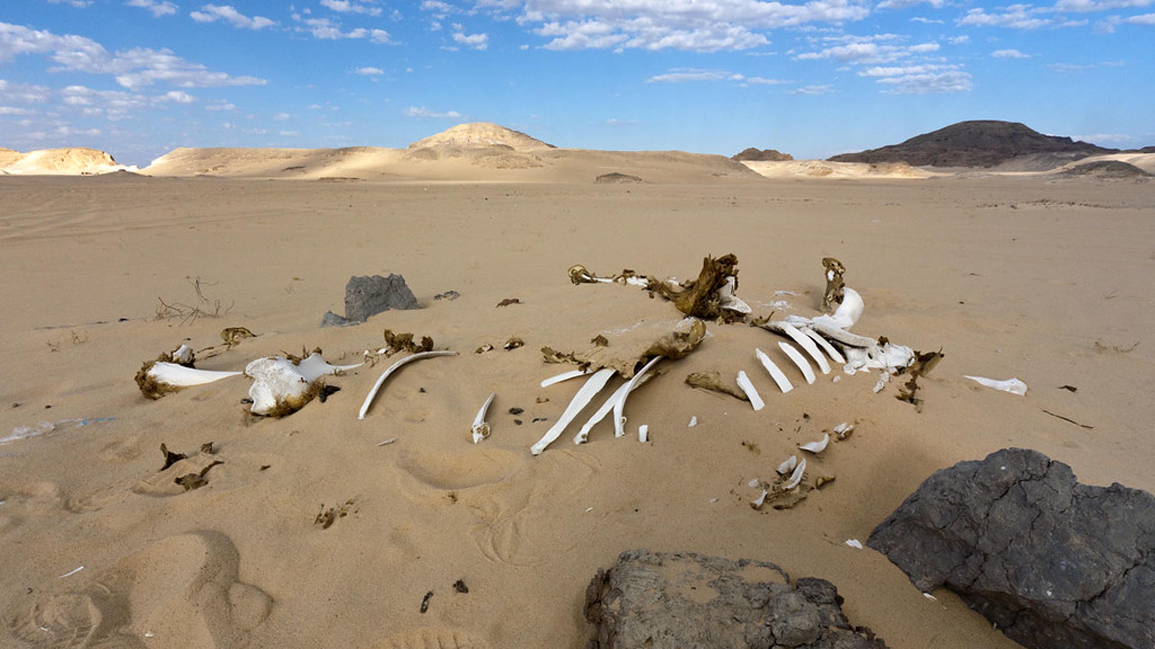
Next verse: Matthew 25:41
Notes:
The Bible teaches that every person who is alive is a living soul. Body + breath (spirit) = a living soul. This was how God made Adam. He breathed into his newly created body the breath of life, and man became a living soul*. When souls die, they cease to exist. Revelation 20:14 says that hellfire is the second death. God has given each of us the opportunity to have eternal life.
Who is hellfire prepared for?
*Genesis 2:7

Slide 37
Matthew 25:41
Then He will also say to those on the left hand, Depart from Me you cursed, into the everlasting fire prepared for the _____ and his ______.
Notes:
.
Matthew 25:41
Then He will also say to those on the left hand, Depart from Me you cursed, into the everlasting fire prepared for the devil and his angels.

Slide 38
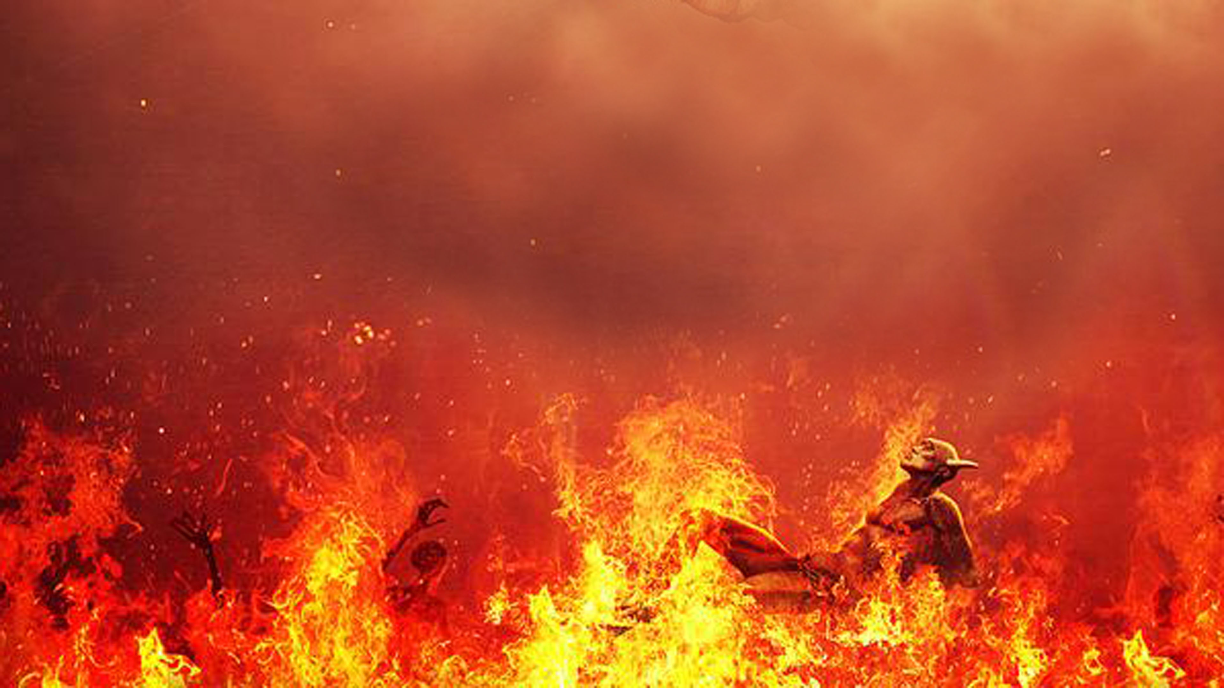
Next verse: Ezekiel 18:23,32
Notes:
Jesus said the fires of hell were prepared for the devil and his angels. No one need join him there. We can choose salvation. Satan has used the doctrine of eternal torment to represent God as a revengeful tyrant who loves to see sinners writhe and burn in eternal flames.
Is this a true picture of God’s character?

Slide 39
Ezekiel 18:23,32
Do I have any pleasure at all that the wicked should die? (32) “For I have __ ________ in the death of one who dies,” says the Lord God. “Therefore turn and live!”
Notes:
.
Isaiah 46:9,10
Do I have any pleasure at all that the wicked should die? (32) “For I have no pleasure in the death of one who dies,” says the Lord God. “Therefore turn and live!”

Slide 40
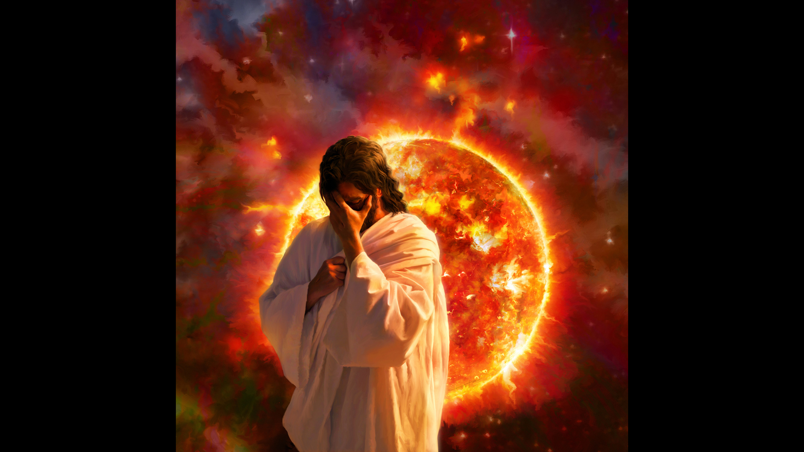
Next verse: Matthew 25:46
Notes:
God takes no pleasure in the death of anyone. The destruction of the wicked is described in the Bible as a “strange act”.* It is in mercy to the universe that God will finally destroy those who reject His grace. The destiny of the wicked is determined by their own choice.
But doesn’t the Bible say they will burn forever?
*Isaiah 28:21 KJV

Slide 41
Matthew 25:46
And these will go away into ___________ punishment, but the righteous into eternal life.”
Notes:
.
Matthew 25:46
And these will go away into everlasting punishment, but the righteous into eternal life.”

Slide 42
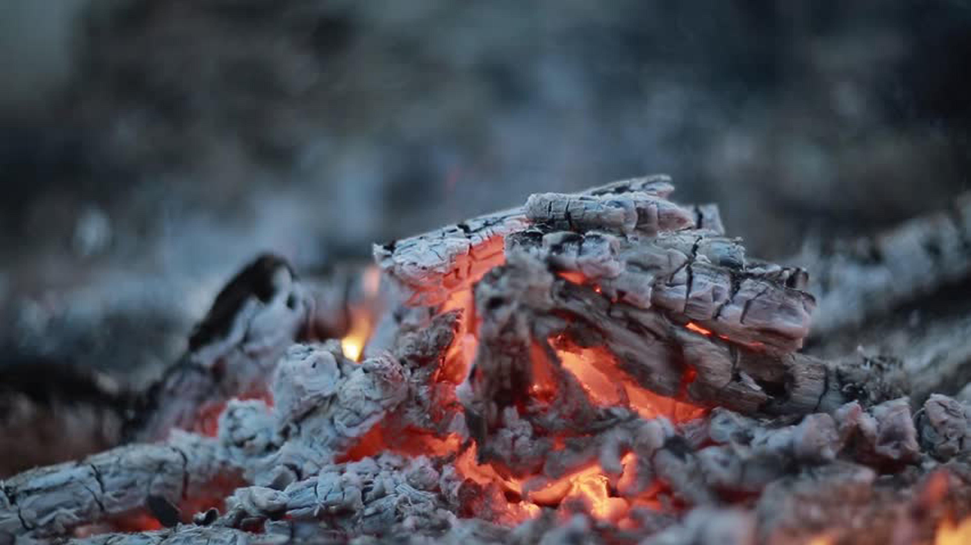
Next verse: Jude 1:7
Notes:
The punishment, not punishing, of the wicked, will be forever. The wicked will be brought to a forever end. When we compare verses, the Bible explains itself. We have seen that they will finally be reduced to ashes.
How does the Bible use similar words to describe the destruction of Sodom and Gomorrah?

Slide 43
Jude 1:7
As Sodom and Gomorrah, and the cities around them in a similar manner to these, having given themselves over to sexual immorality and gone after strange flesh, are set forth as an example, suffering the vengeance of _______ ____.
Notes:
.
Jude 1:7
As Sodom and Gomorrah, and the cities around them in a similar manner to these, having given themselves over to sexual immorality and gone after strange flesh, are set forth as an example, suffering the vengeance of eternal fire.

Slide 44
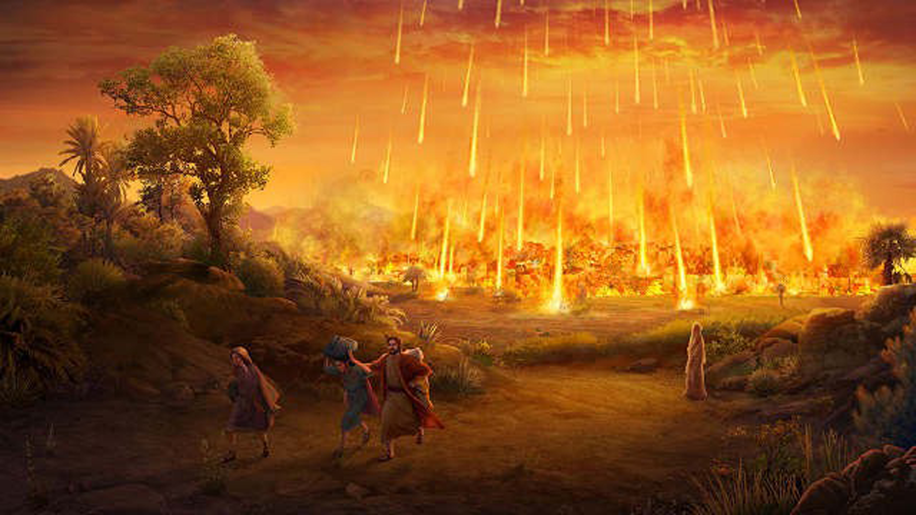
Next verse: 2 Peter 2:6
Notes:
The Bible says that the wicked cities of Sodom and Gomorrah in the time of Abraham were destroyed by eternal fire. Are they still burning today?

Slide 45
2 Peter 2:6
And turning the cities of Sodom and Gomorrah into _____, condemned them to destruction, making them an example to those who afterward would live ungodly.
Notes:
.
2 Peter 2:6
And turning the cities of Sodom and Gomorrah into ashes, condemned them to destruction, making them an example to those who afterward would live ungodly.

Slide 46
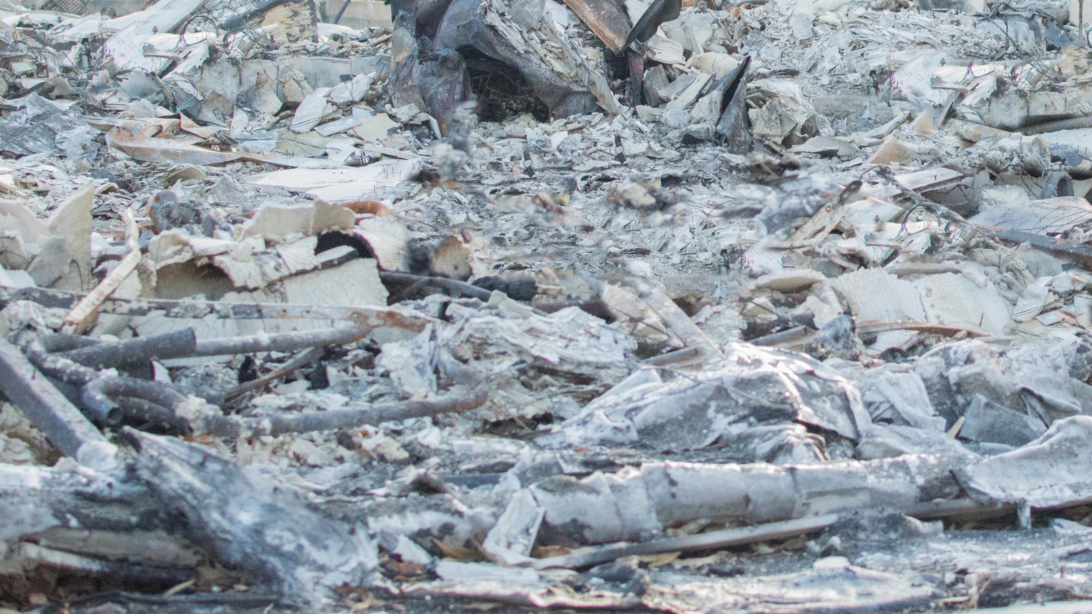
Next verse: Revelation 20:14
Notes:
The fire burned Sodom and Gomorrah to ashes, making an eternal end to them.
What is the result of the lake of fire?

Slide 47
Revelation 20:14
Then Death and Hades were cast into the lake of fire. This is the _______ _____.
Notes:
.
Revelation 20:14
Then Death and Hades were cast into the lake of fire. This is the second death.

Slide 48
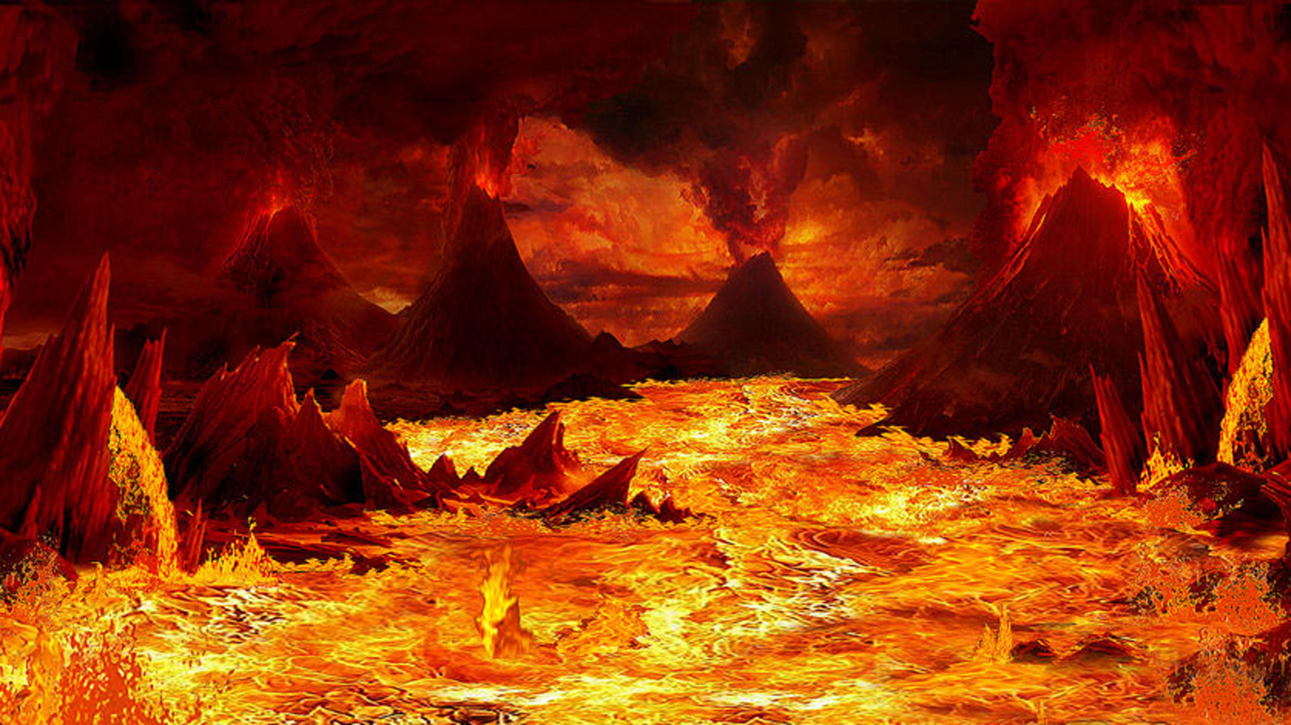
Next verse: Matthew 3:11,12
Notes:
This verse shows us that the lake of fire results in death for all who are burned there.
Doesn’t the Bible say the fire is unquenchable?

Slide 49
Matthew 3:11,12
I indeed baptize you with water unto repentance, but He will baptize you with the Holy Spirit and fire. (12) His winnowing fan is in His hand, and He will thoroughly clean out His threshing floor, and gather His wheat into the barn; but He will burn up the chaff with ____________ fire.
Notes:
.
Matthew 3:11,12
I indeed baptize you with water unto repentance, but He will baptize you with the Holy Spirit and fire. (12) His winnowing fan is in His hand, and He will thoroughly clean out His threshing floor, and gather His wheat into the barn; but He will burn up the chaff with unquenchable fire.

Slide 50
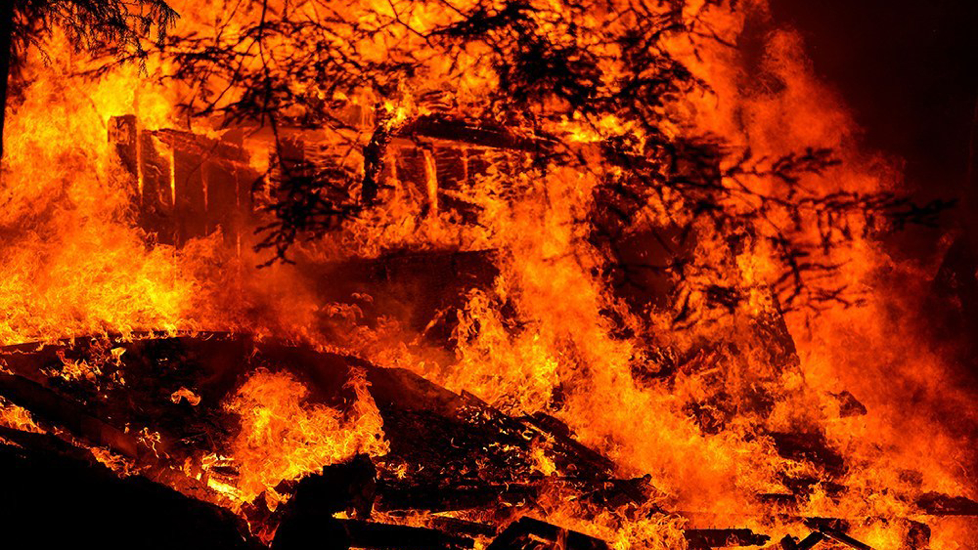
Next verse: Jeremiah 17:27
Notes:
The Bible does use the word “unquenchable”. How does the Bible use similar language to describe the destruction of Jerusalem?

Slide 51
Jeremiah 17:27
“But if you will not heed Me to hallow the Sabbath day, such as not carrying a burden when entering the gates of Jerusalem on the Sabbath day, then I will kindle a ____ in its gates, and it shall devour the palaces of Jerusalem, and it shall not be ________.”
Notes:
.
Jeremiah 17:27
“But if you will not heed Me to hallow the Sabbath day, such as not carrying a burden when entering the gates of Jerusalem on the Sabbath day, then I will kindle a fire in its gates, and it shall devour the palaces of Jerusalem, and it shall not be quenched.”

Slide 52
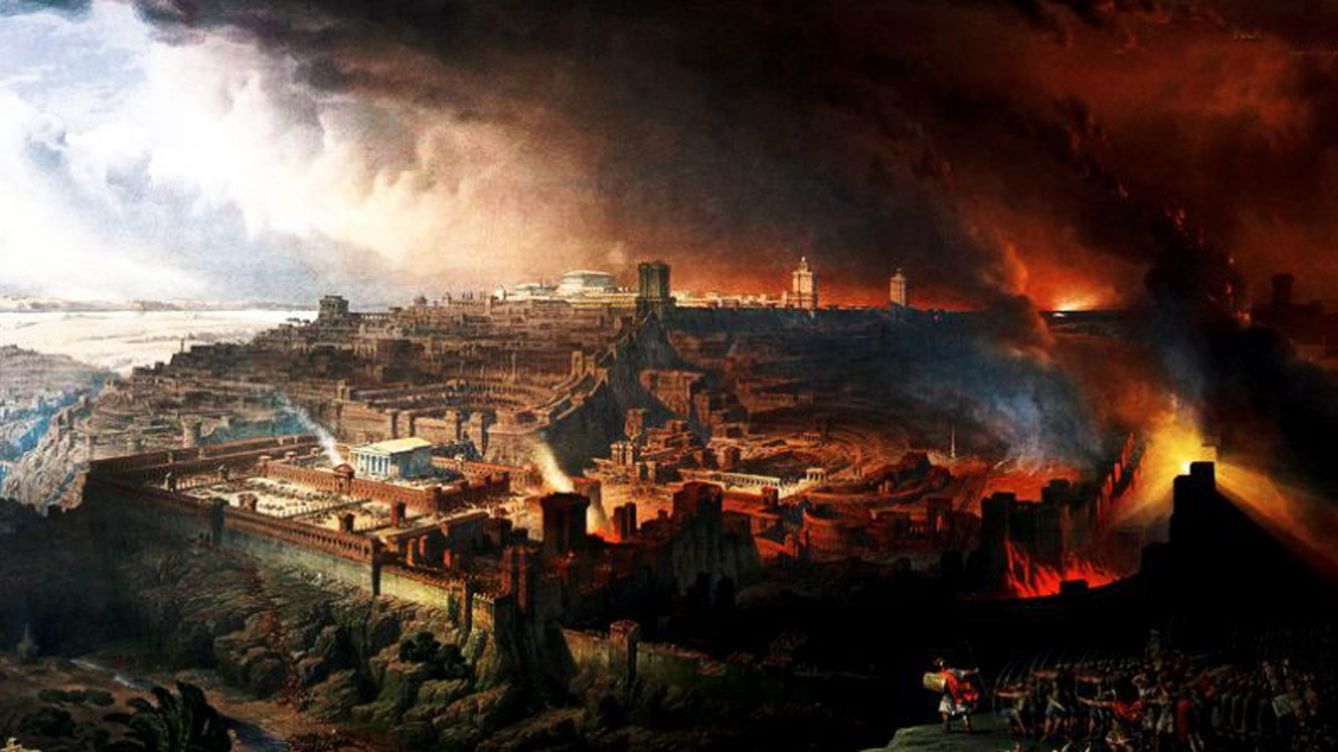
Next verse: Ezekiel 28:17,18
Notes:
Jerusalem is not still burning today. The Bible uses the words unquenchable fire to describe a fire that cannot be put out until it has done its work.
Is Satan finally destroyed as well?

Slide 53
Ezekiel 28:17,18
Your heart was lifted up because of your beauty; you corrupted your wisdom for the sake of your splendor; I cast you to the ground, I laid you before kings, that they might gaze at you. (18) You defiled your sanctuaries by the multitude of your iniquities, by the iniquity of your trading; therefore I brought fire from your midst; It devoured you, and I turned you to _____ upon the earth in the sight of all who saw you.
Notes:
.
Ezekiel 28:17,18
Your heart was lifted up because of your beauty; you corrupted your wisdom for the sake of your splendor; I cast you to the ground, I laid you before kings, that they might gaze at you. (18) You defiled your sanctuaries by the multitude of your iniquities, by the iniquity of your trading; therefore I brought fire from your midst; It devoured you, and I turned you to ashes upon the earth in the sight of all who saw you.

Slide 54
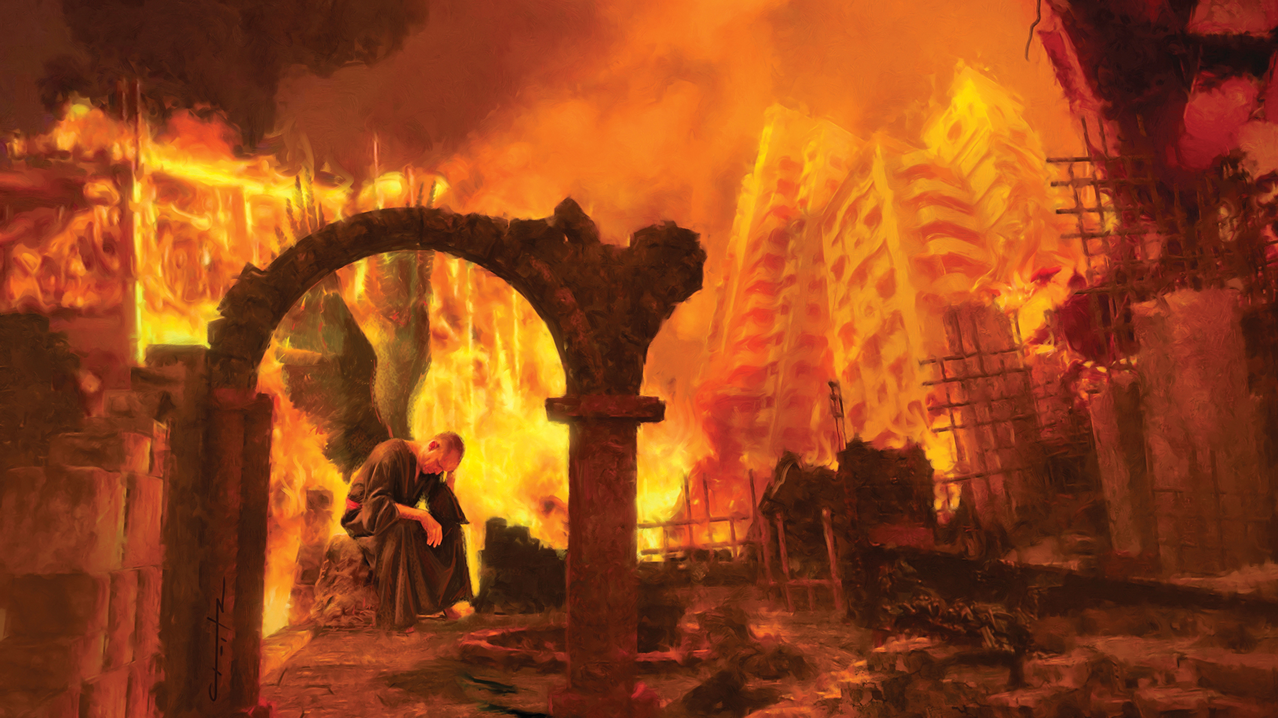
Next verse: Revelation 20:10; 14:11
Notes:
Satan will finally be consumed. The Bible says that he, along with his angels and the wicked, will be “brought to ashes”. Some are destroyed instantly, while others suffer for many days. Romans 2:6 tells us that all are punished “according to their deeds”. Satan is the originator of sin and the one responsible for all the sins he has caused God’s people to commit. He will suffer longer than any of those he has deceived. But finally his terrible work of ruin is ended.
Doesn’t the Bible say the wicked will burn forever?

Slide 55
Revelation 20:10
The devil, who deceived them, was cast into the lake of fire and brimstone where the beast and the false prophet are. And they will be tormented day and night _______ and ever.
Revelation 14:11
And the smoke of their torment ascends _______ and ever; and they have no rest day or night, who worship the beast and his image, and whoever receives the mark of his name.
Notes:
.
Revelation 20:10
The devil, who deceived them, was cast into the lake of fire and brimstone where the beast and the false prophet are. And they will be tormented day and night forever and ever.
Revelation 14:11
And the smoke of their torment ascends forever and ever; and they have no rest day or night, who worship the beast and his image, and whoever receives the mark of his name.

Slide 56
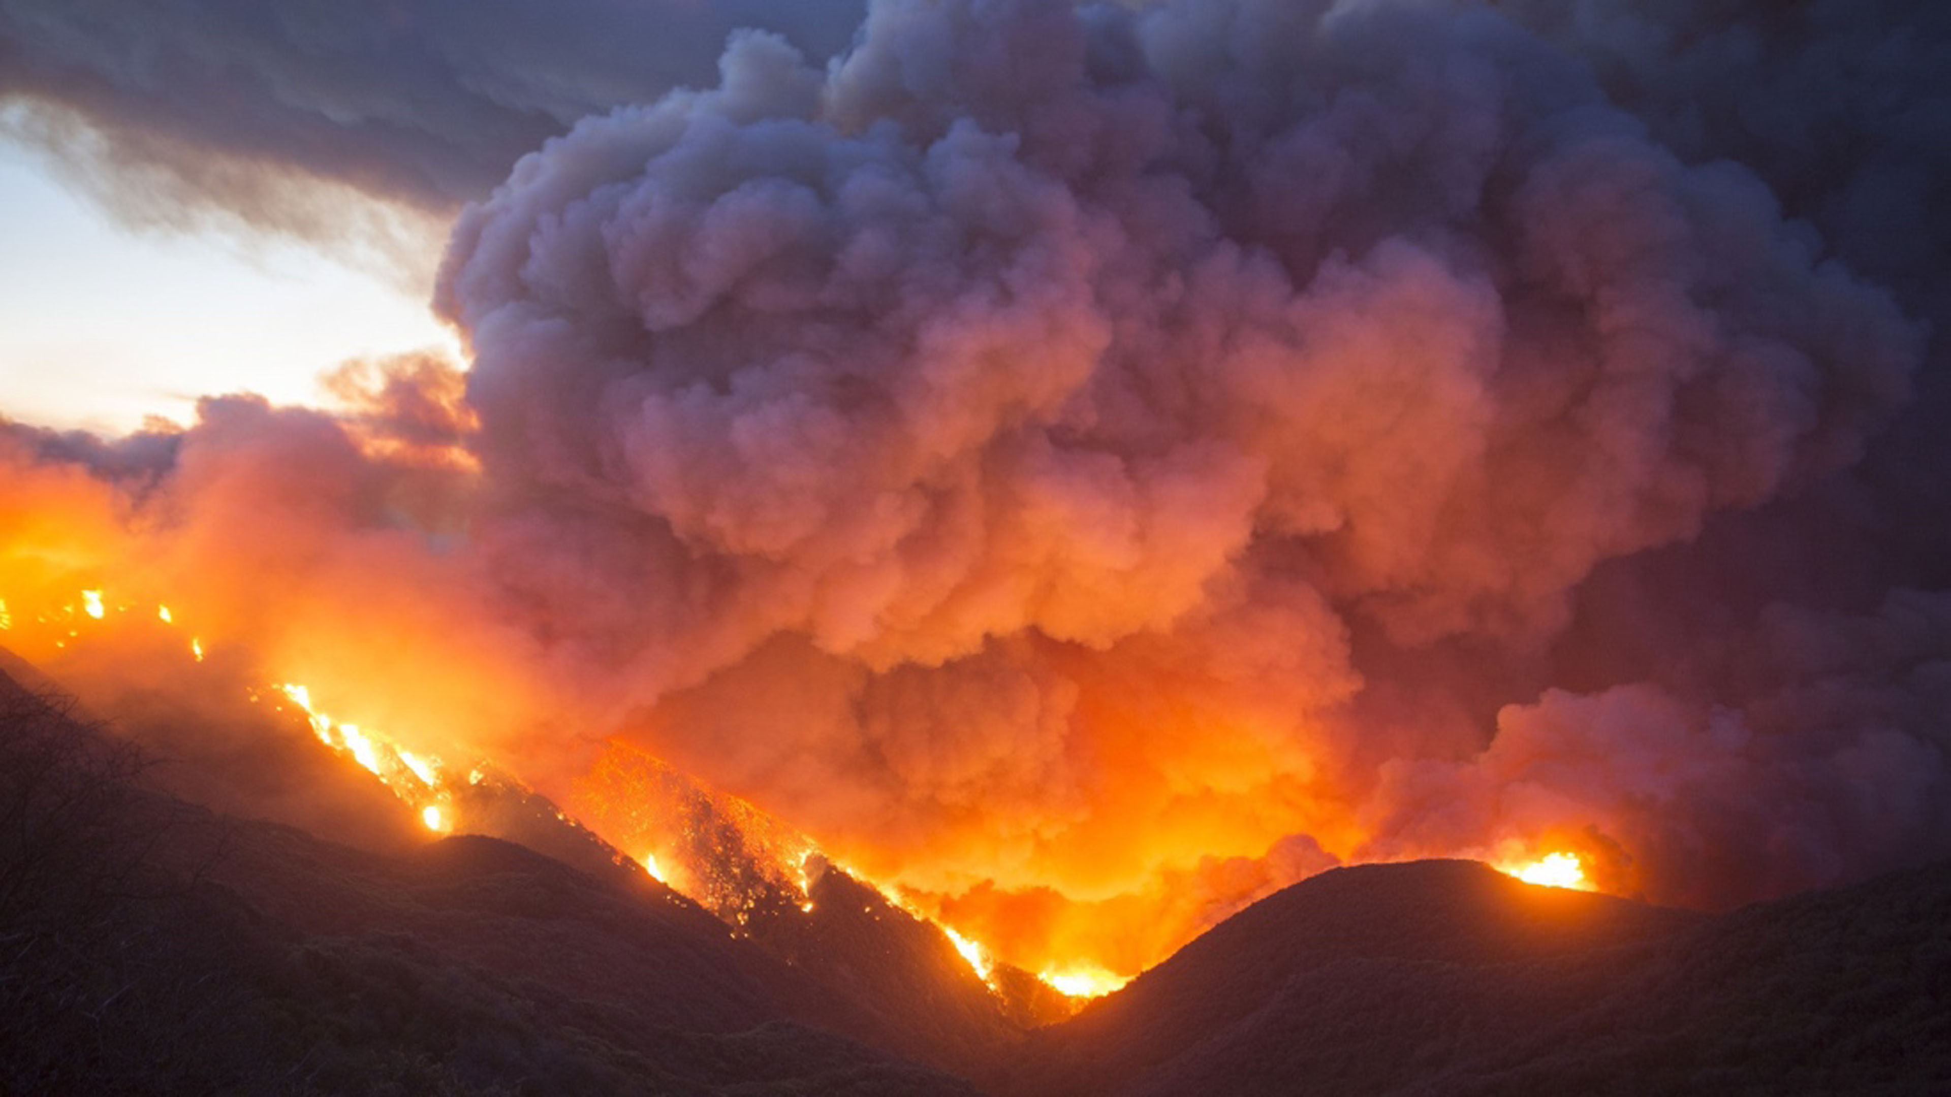
Next verse: 1 Samuel 1:22, 28
Notes:
Let’s compare some other verses in the Bible to understand how the word “forever” is used.

Slide 57
1 Samuel 1:22,28
But Hannah did not go up, for she said to her husband, “Not until the child is weaned; then I will take him, that he may appear before the LORD and remain there _______. (28) Therefore I also have lent him to the Lord; as long as he _____ he shall be lent to the Lord.”
Notes:
.
1 Samuel 1:22, 28
But Hannah did not go up, for she said to her husband, “Not until the child is weaned; then I will take him, that he may appear before the LORD and remain there forever…
(28) Therefore I also have lent him to the Lord; as long as he lives he shall be lent to the Lord.”

Slide 58
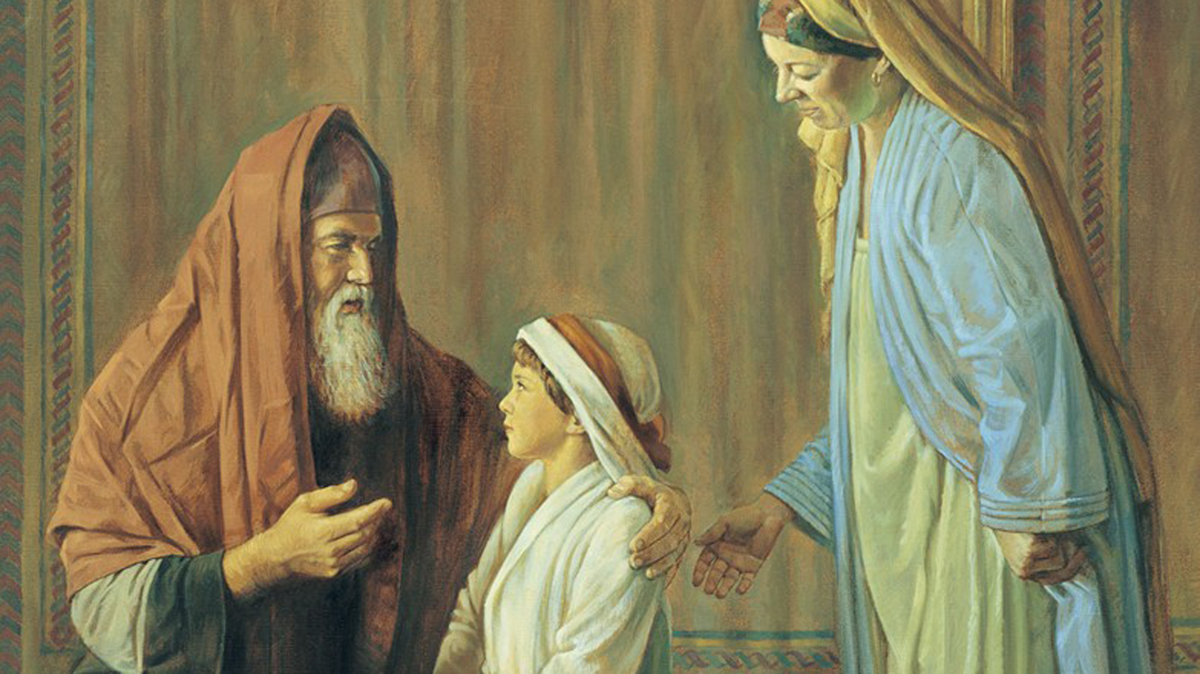
Next verse: Jonah 2:5,6; 1:17
Notes:
Hannah said she lent Samuel to the Lord forever, meaning, for as long as he would live. The wicked are burned forever, as long as they live. They have a forever end.
How did Jonah describe his experience in the belly of the whale?

Slide 59
Jonah 2:5,6
The waters surrounded me, even to my soul; The deep closed around me; weeds were wrapped around my head. (6) I went down to the moorings of the mountains; the earth with its bars closed behind me _______…
Jonah 1:17
Now the Lord had prepared a great fish to swallow Jonah. And Jonah was in the belly of the fish _____ days and _____ nights.
Notes:
.
Jonah 2:5,6
The waters surrounded me, even to my soul; The deep closed around me; weeds were wrapped around my head. (6) I went down to the moorings of the mountains; the earth with its bars closed behind me forever...
Jonah 1:17
Now the Lord had prepared a great fish to swallow Jonah. And Jonah was in the belly of the fish three days and three nights.

Slide 60
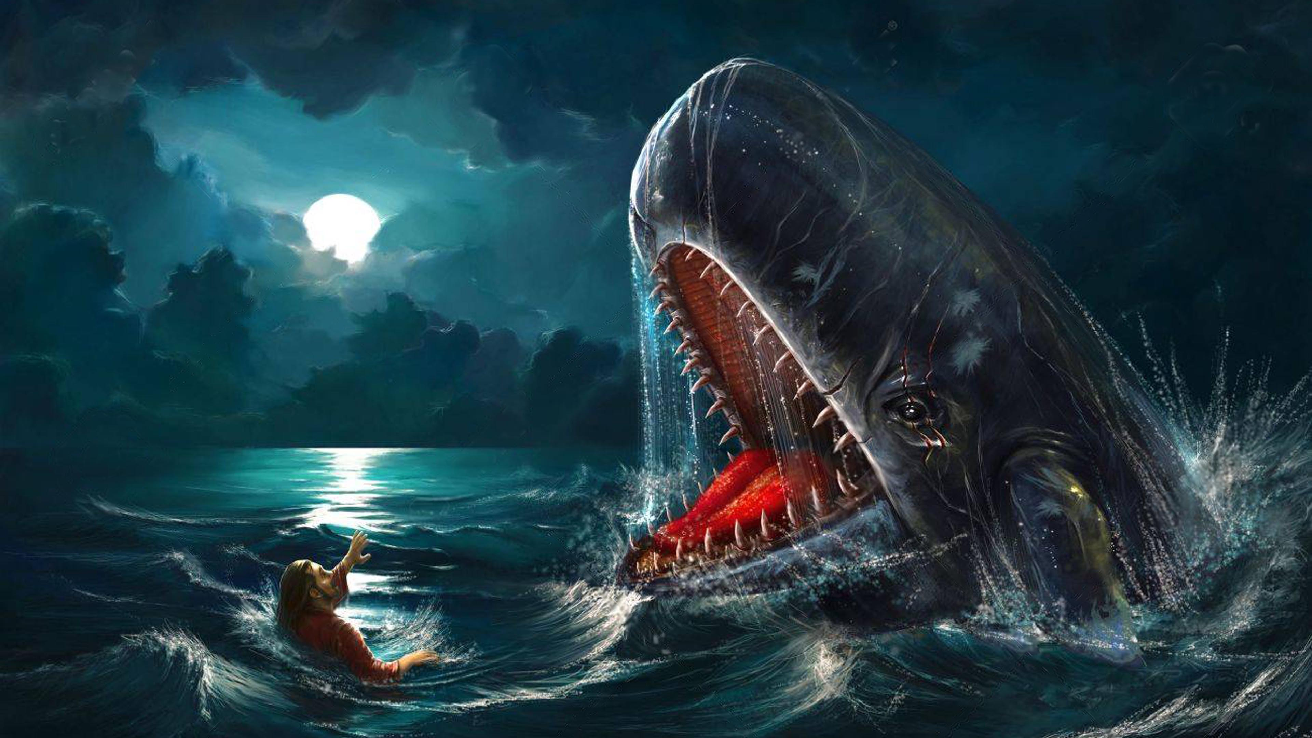
Next verse: Revelation 20:15
Notes:
These verses show us that Jonah’s “forever” experience in the whale lasted “three days and three nights”. The lake of fire will last until the wicked are burned up, turned to ashes, annihilated, consumed.
How can we avoid the lake of fire?

Slide 61
Revelation 20:15
And anyone not found written in the ____ of ____ was cast into the lake of fire.
Notes:
.
Revelation 20:15
And anyone not found written in the Book of Life was cast into the lake of fire.

Slide 62
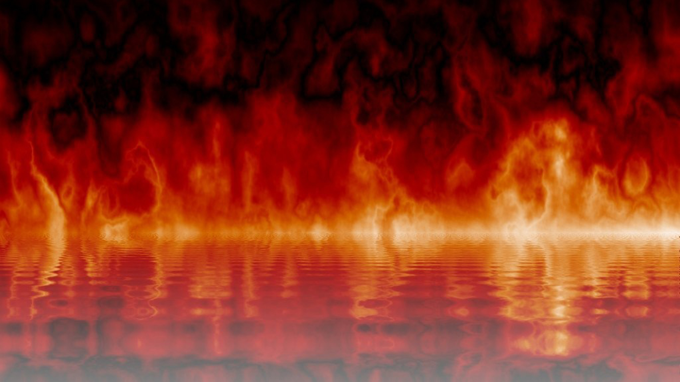
Next verse: Luke 10:20, Philippians 4:3; Revelation 21:27
Notes:
The Bible says that those whose names are not written in the Book of Life will end up in the lake of fire.
What is the Book of Life and how can we make sure our names are there?

Slide 63
Luke 10:20
“...rejoice because your names are written in ______.”
Philippians 4:3
...my fellow workers, whose names are in the ____ of ____.
Revelation 21:27
But there shall by no means enter it anything that defiles, or causes an abomination or a lie, but only those who are written in the Lamb’s ____ of ____.
Notes:
.
Luke 10:20
“...rejoice because your names are written in heaven.”
Philippians 4:3
...my fellow workers, whose names are in the Book of Life.
Revelation 21:27
But there shall by no means enter it anything that defiles, or causes an abomination or a lie, but only those who are written in the Lamb’s Book of Life.

Slide 64
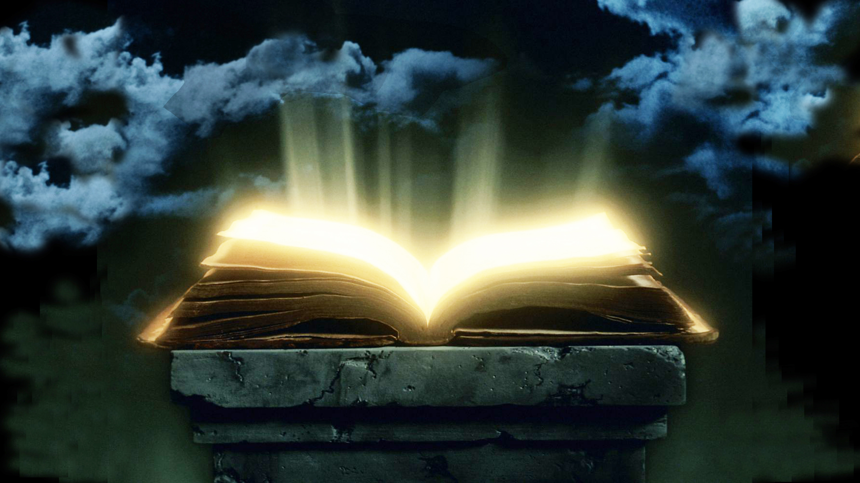
Next verse: Revelation 3:5
Notes:
Jesus told His disciples that their names were written in heaven. The book of life has the names of all who have ever become followers of Christ. Names of those with unconfessed, unforsaken sins will be removed in the judgment, and they will not enter God’s kingdom. What did Jesus promise the overcomers?

Slide 65
Revelation 3:5
He who overcomes shall be clothed in white garments, and I will not blot out his name from the ____ of ____; but I will confess his name before My Father and before His angels.
Notes:
.
Revelation 3:5
He who overcomes shall be clothed in white garments, and I will not blot out his name from the Book of Life; but I will confess his name before My Father and before His angels.

Slide 66
Next verse: Revelation 14:9,10; 13:8
Notes:
The issue in the last days will be about worship. How do we know this will be the final test?

Slide 67
Revelation 14:9,10; 13:8
Then a third angel followed them, saying with a loud voice, “If anyone ________ the _____ and his image, and receives his mark on his forehead or on his hand, (10) he himself shall also drink of the wine of the wrath of God...He shall be tormented with fire and brimstone in the presence of the holy angels and in the presence of the Lamb.
(Rev. 13:8) All who dwell on the earth will _______ him, whose names have not been written in the ____ of ____ of the Lamb slain from the foundation of the world.
Notes:
.
Revelation 3:5
Then a third angel followed them, saying with a loud voice, “If anyone worships the beast and his image, and receives his mark on his forehead or on his hand, (10) he himself shall also drink of the wine of the wrath of God...He shall be tormented with fire and brimstone in the presence of the holy angels and in the presence of the Lamb.
(Rev. 13:8) All who dwell on the earth will worship him, whose names have not been written in the Book of Life of the Lamb slain from the foundation of the world.

Slide 68
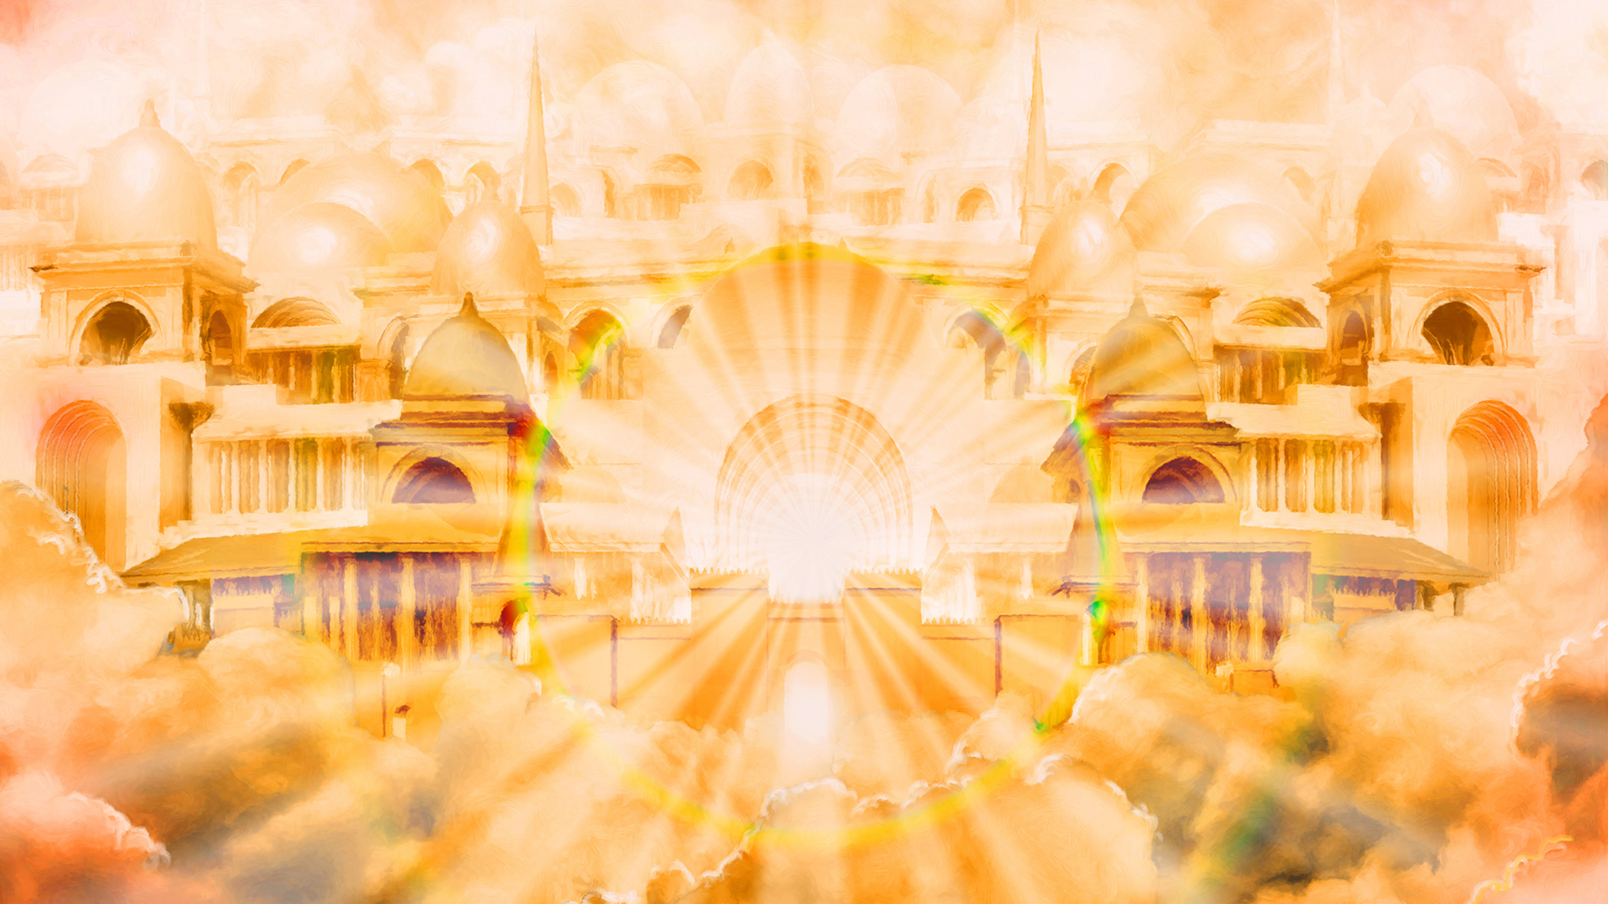
Next verse: Revelation 14:12; 15:2
Notes:
In contrast to those who worship the beast, how are God’s end-time people described in Revelation, and what is their reward?

Slide 69
Revelation 14:12
Here is the patience of the saints; here are those who keep the ____________ of God and the faith of Jesus.
Revelation 15:2
And I saw something like a sea of glass mingled with fire, and those who have the _______ over the _____, over his image and over his mark and over the number of his name, standing on the sea of glass, having harps of God.
Notes:
.
Revelation 14:1,2
Here is the patience of the saints; here are those who keep the commandments of God and the faith of Jesus.
Revelation 15:2
And I saw something like a sea of glass mingled with fire, and those who have the victory over the beast, over his image and over his mark and over the number of his name, standing on the sea of glass, having harps of God.

Slide 70
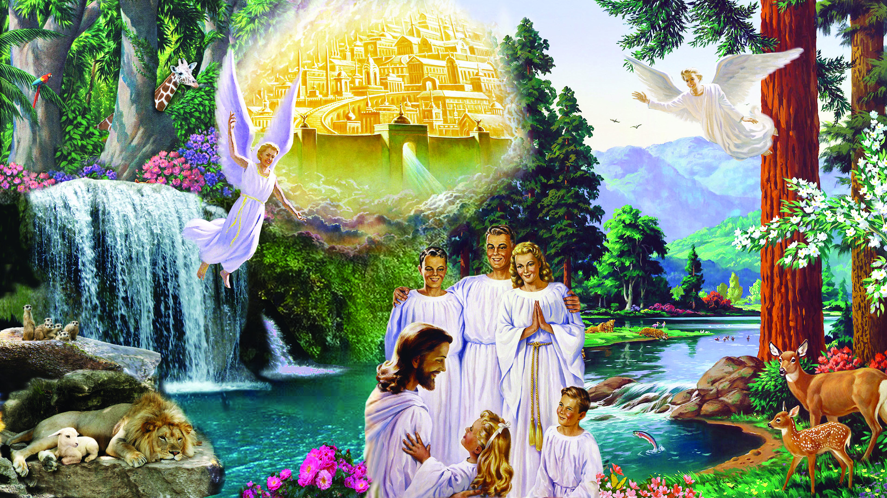
Notes:
These are the overcomers. The wicked have burned in the lake of fire, but the righteous stand on the sea of glass before God’s throne. Every trace of sin is gone. The earth is transformed, with no more death, sorrow, crying or pain anywhere. God Himself will live with His people. There is no ever-burning hell to remind anyone of the consequences of sin.
All who have chosen not to receive eternal life have been blotted out of existence, and God has made “all things new”*. Will you choose to let Him be the Lord of your life today?
*Revelation 21:3,4,5

